Slide 1

NATIONAL HOLIDAYS IN THE UK
The members of our group are: Logunova Anna, Chramtsova Irina, Rosina Marína and Sirotkina Darya

Slide 2
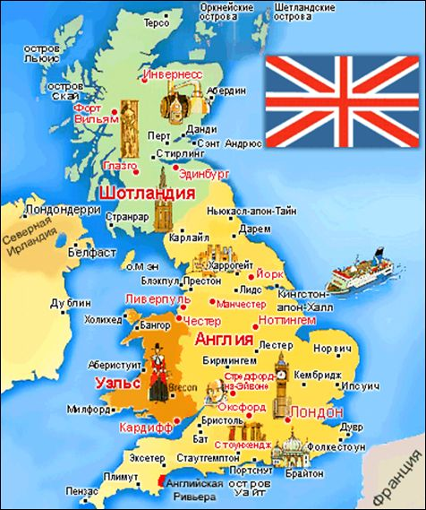
All peoples have their national holidays, traditions and customs, unique to their culture. Festive events for the citizens of each country, prepare for it and looking forward to celebrate with pleasure and regret to leave until next year. English holidays is an integral part of the culture of the English-speaking world, a way of expression, the Source of habits and behavior. Often, to understand the nature of the soul and upon the inhabitants of a particular country, it is necessary to be acquainted with their customs and traditions. Let's look at the most famous festivals celebrated by the inhabitants of English-speaking countries.

Slide 3
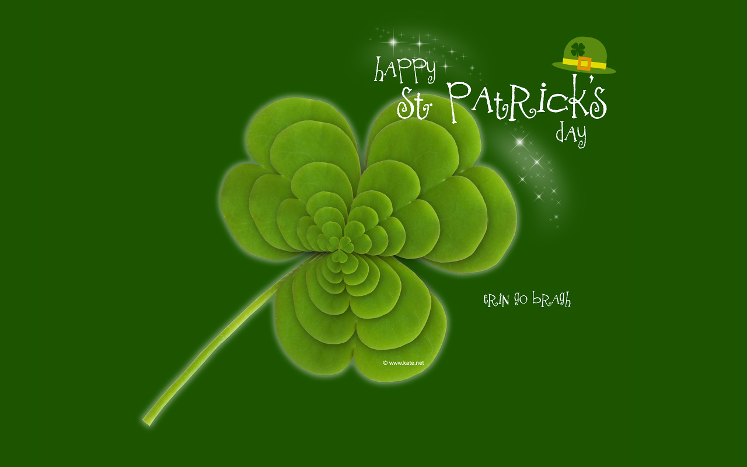
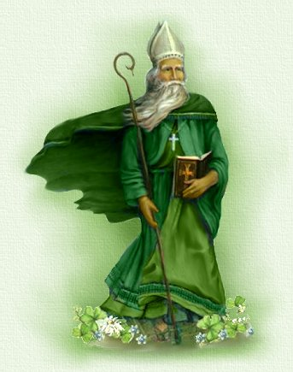
St. Patrick's Day(Ireland)
St. Patrick’s Day is celebrated every year on March 17th in honor of Saint Patrick of Ireland. He was the patron of Ireland, and a saint who brought Christianity to the nation. Saint Patrick is also known for driving the snakes away from Ireland. The national symbol of Ireland is shamrock and according to legend Saint Patrick chose this plant to illustrate the Holy Trinity to the Irish. Nobody knows exactly why St. Patrick’s Day is celebrated on March 17th. However, there is a theory that on this day Saint Patrick died. Originally the holiday was celebrated only in Ireland but today a lot of countries in the world celebrate it. Traditional activities include dressing up in green clothes, holding parades, arranging fireworks, singing and dancing in the streets, going to pubs, organizing fairs and festival

Slide 4
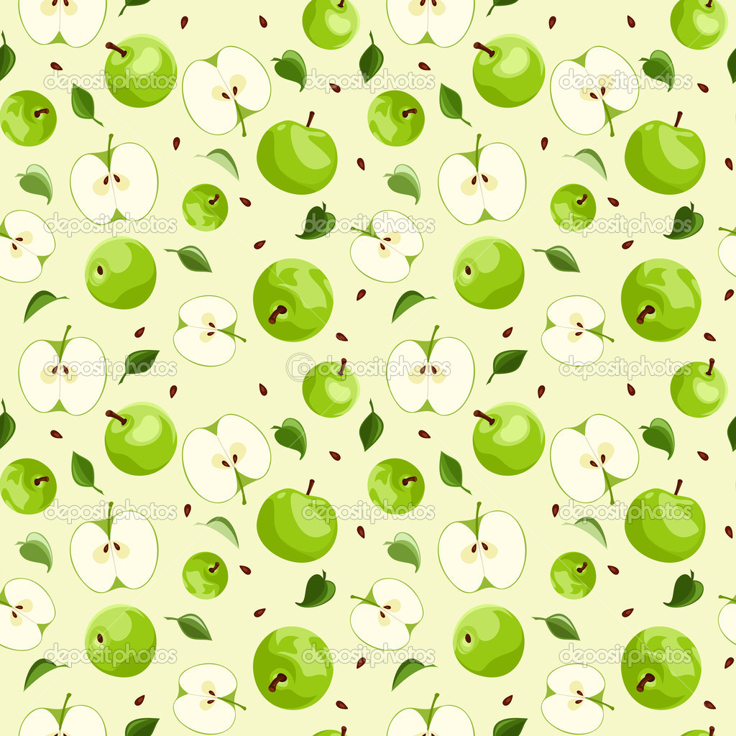
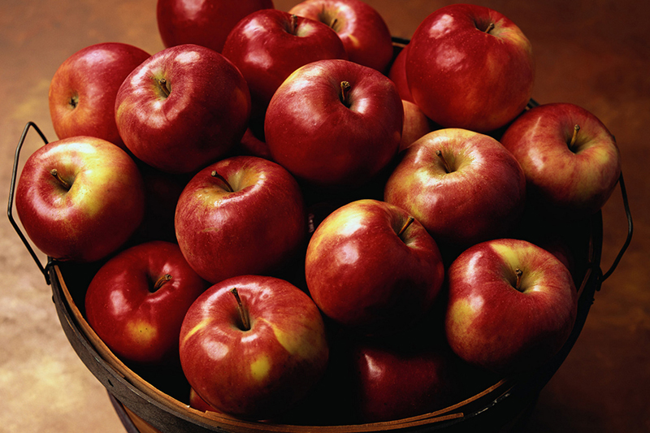
Apple Day( Еngland)
On October 21 in England held Apple Day — the annual action devoted to apples, orchards and local sights which is organized since 1990. In Day of apple it is possible to see and try hundreds of various grades of apples, and, many of the available grades aren't on sale in usual shops. About each grade to you will tell story (or a legend).
British consider that Day of apple is celebration and demonstration of variety and richness of the nature. The idea of Day is that apple is a symbol of a physical, cultural diversity about which the person shouldn't forget.

Slide 5
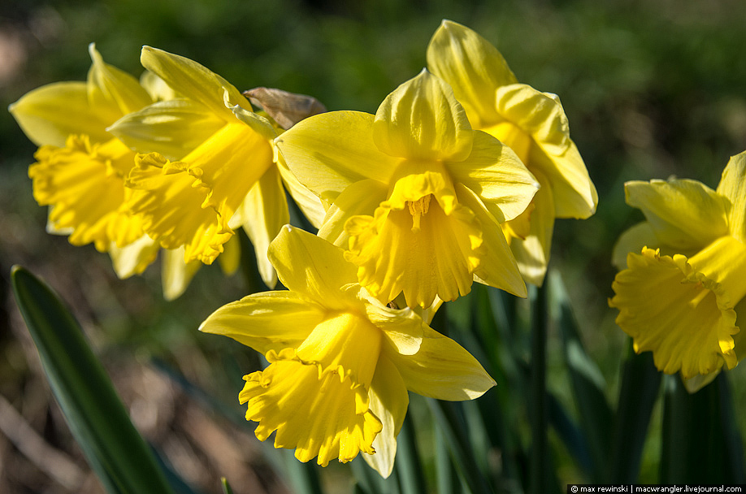
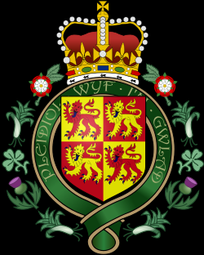
St David's Day(Wales)
At the beginning of spring, on March 1, Wales covered by the festive mood. Carnivals, festivals, processions in national costumes, interesting thematic views, luxurious dinners with your favorite dishes — Welsh celebrate the most important national holiday, St David's Day. This Saint had a great influence on the spreading of Christianity in Wales, so as a sign of gratitude, the residents of Wales, St David's day. Many Welshmen attach to clothes national symbols of this holiday —a daffodil or leek

Slide 6

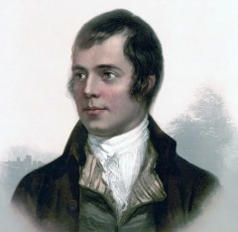
Birthday of Robert Burns(Scotland)
The national holiday — Birthday of the outstanding poet Robert Byorns (on January 25) is widely celebrated on his homeland in Scotland. Scots very much are proud of the famous compatriot and revere his memory.
In Scotland Byorns is esteemed as a nation symbol and therefore birthday of the poet — one of the most favourite holidays in the country of hills — is celebrated widely and is noisy. This day Scots get national suits from clothes. A kilt and the drawing of fabric — the Scotswoman.

Slide 7
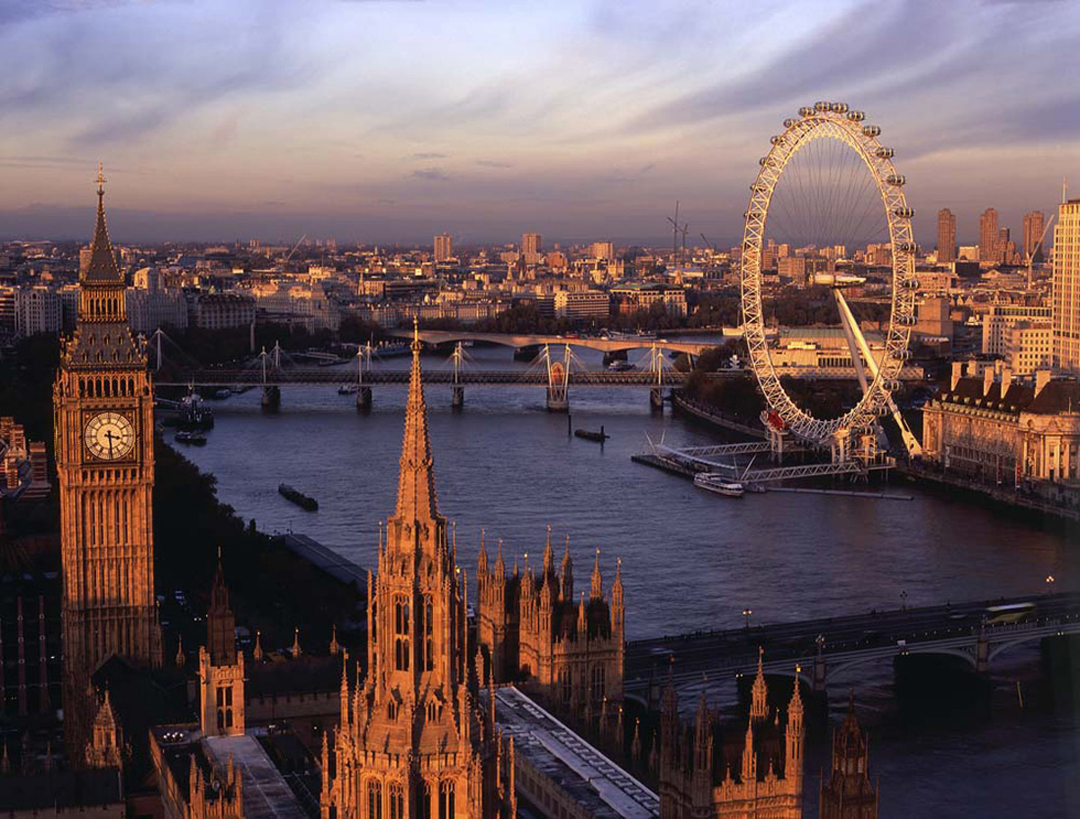
In England many different holidays that celebrate throughout the year: public, so-called legal holidays, religious and traditional, important events of national history, festivals. The best way to get in touch with the British tradition is to get on one of them. Some of the festivals have origins in the distant past, while others are relatively new, modern.

Slide 8
Thank you
for your attention

