Slide 1
Rare extinct animals
Авторы проекта: учащиеся 5В класса МБОУ «Школа № 41»
Логунова Анна
Медведева Наталья
Салахова Лейла
Студёнов Никита

Slide 2
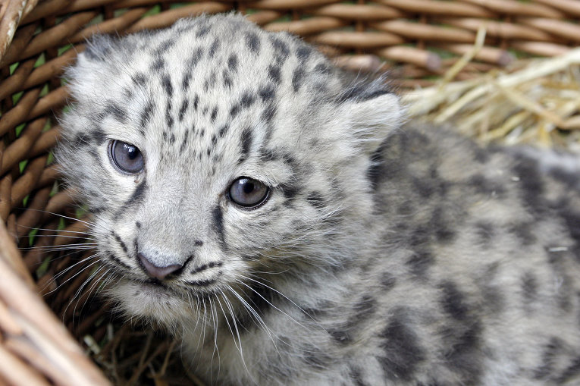
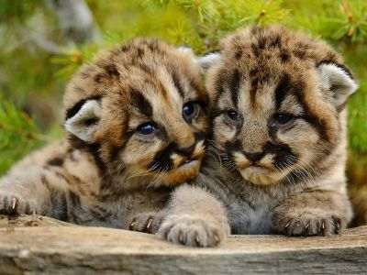
The diversity of the fauna is one of the main features of our planet. But for various reasons the populations of certain animals, birds, fish, reptiles are declining gradually and reach fe atures. Some animals are killed for meat or skins, some replacing competing, some lose their familiar habitat due to natural and man-made disasters. Whatever the reasons for the extinction of animals, the fact remains that in a few decades many living creatures can be seen except on the photographs or frames of video footage.

Slide 3
The most famous extinct animals:
By far the best known species of animals that are threatened with extinction, are :
the blue whale,
polar bear,
mountain gorilla,
cassowary,
Ussurisky Tiger
and the giant panda.

Slide 4
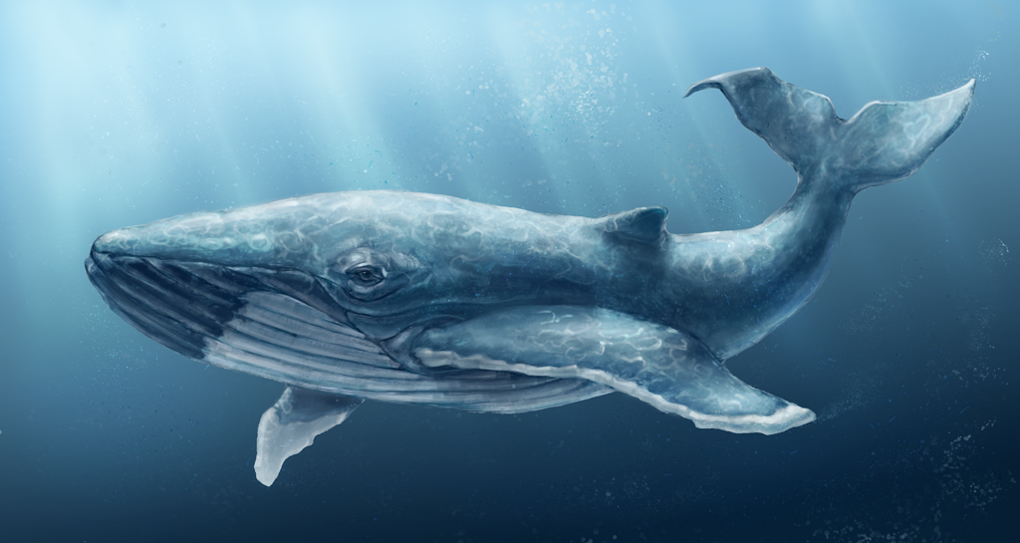
The blue whale is dying out due to lack of nutrition. Ozone depletion leads to reduction of quantity of zooplankton in the waters of the oceans, and it is the main food for whales.

Slide 5
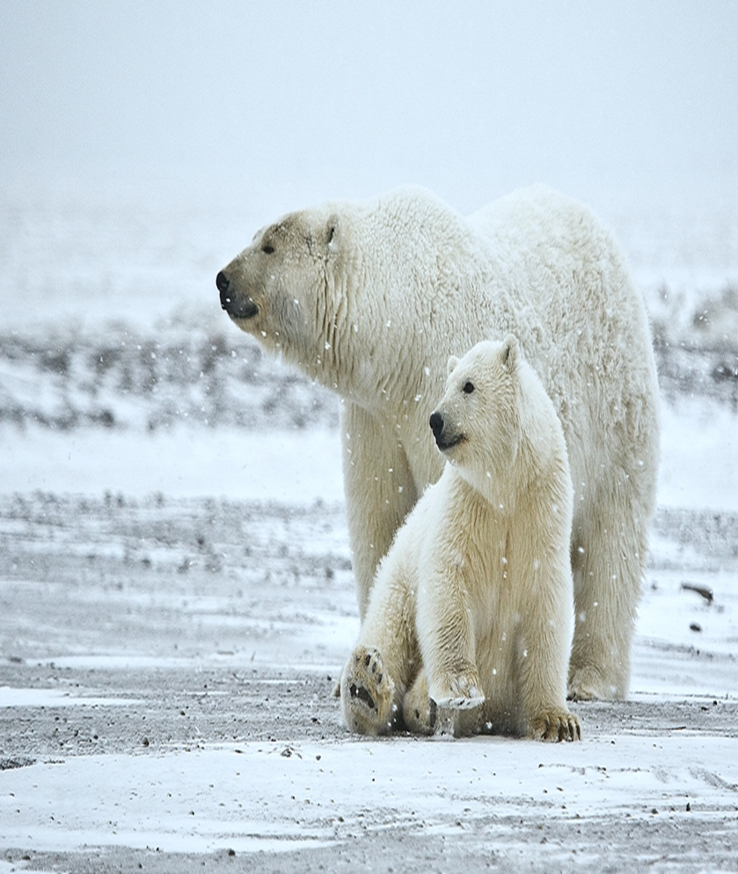
The population of polar bears gradually disappears due to global warming. Animals have to go deeper in the Arctic tundra, and those animals that remain on their former habitats, are interbreed with the brown bears.

Slide 6
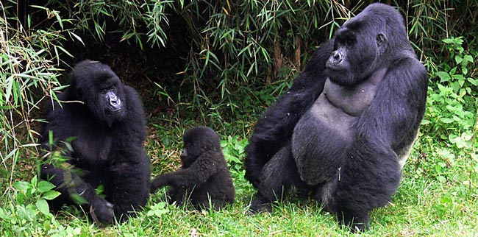
Deforestation and poachers cause reduction of the population of mountain gorillas.

Slide 7
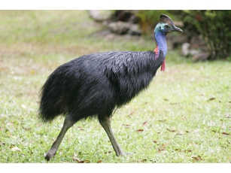
Cassowary - the second-largest bird in the world, living in Australia. Cause a significant reduction of its population has been the development of pig industry. Pigs ravage nests of birds and destroy their eggs. Scientists are worried about the Australian and New Zealand fauna, because it is one of the most unusual and diverse in the world. Unfortunately, thousands of poachers cause great harm to nature.

Slide 8
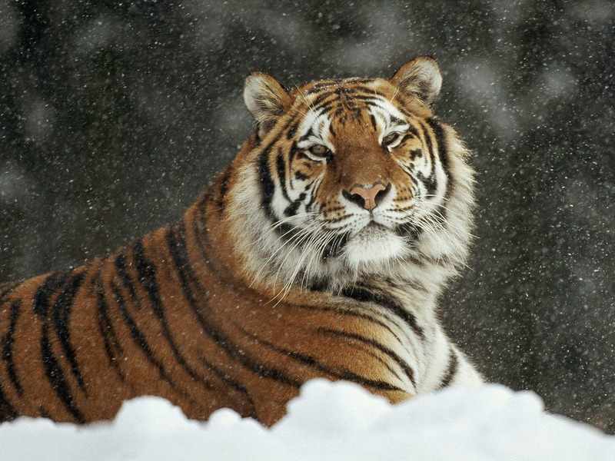
Probably not a single person in the world who wouldn't know about the threat of the disappearance of Siberian Tigers. Formidable master of Taiga attracts poachers with its beautiful skin, bones and internal organs, which are used in traditional Chinese medicine. By the way, not only threatens cause the extinction of the Ussurisky tigers, but also all other kinds of tigers in India, for example, there are only 1 thousand tigers, and in Russia-not more than 400.

Slide 9
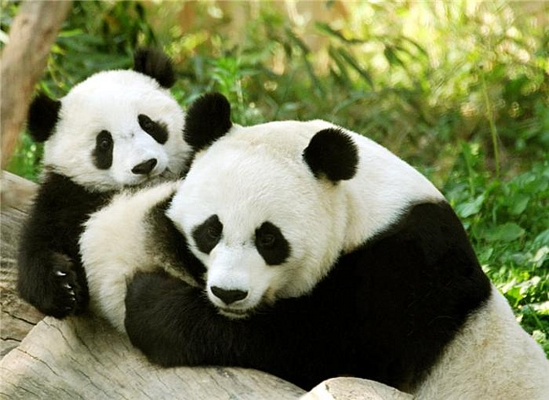
In the extinction of the big pandas the man is also guilty. The reason for that active development of industry in the region of the upper Yangtze. Besides the pandas don’t have non-existent instinct of self-preservation, which also helps to reduce its size.

Slide 10
What measures are being taken to protect endangered animals?
In 19-20 centuries mankind has become concerned about the extinction of animals and was taking various measures aimed at the preservation of the diversity of creatures that inhabit our planet. Today, all countries in the world have laws governing hunting and fishing. Some animals, birds and fish may not be catching at all, others are allowed to produce only in certain areas and at certain times. Poachers, especially those who destroy rare animals expose to the criminal and administrative sanctions.
Rare and endangered species of animals recorded in the "Red Book" and its national and regional counterparts. Unfortunately, these documents are little known to a wide range of people.
To protect the animal from extinction in habitats created nature reserves and wildlife sanctuaries. This measure is highly effective. For example, Astrakhan reserve and the Barguzinsky reserve.

Slide 11
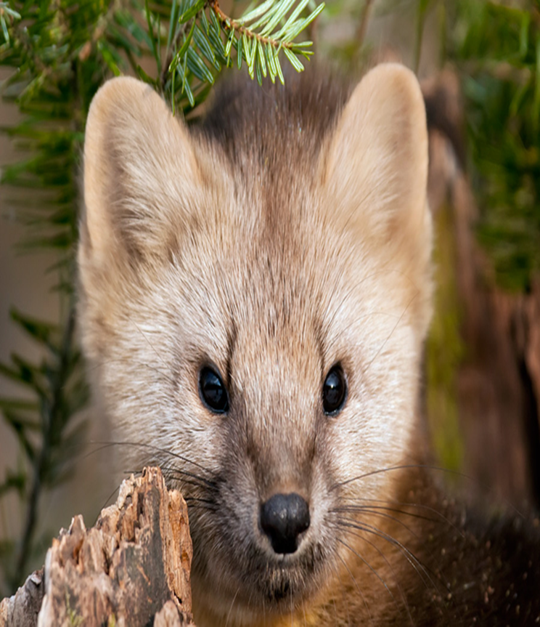
Barguzin reserve
In the central part of the Respublic of Buryatia is the oldest nature reserve in Russia named Barguzin. It was created in 1916 to preserve the unique nature on the western slope of the barguzinsky mountain range and the eastern shore of Lake Baikal. In the early 20 century in these places poachers rapidly destroyed the Sable population, and therefore it was decided to protect local flora and fauna at the State level.

Slide 12

Greenpeace is a non-governmental environmental organization with offices in more than forty countries and with the international coordinating body in Amsterdam, Holland. founded Canadian activists in 1971, Greenpeace States its goal is to "ensure the ability of the land to develop life in all its diversity" and focuses its campaign throughout the world on issues such as climate change, deforestation, overfishing, commercial whaling, genetic engineering, and anti-nuclear issue. It uses direct action, lobbying and research to achieve its goals. Global organization does not accept funding from Governments, corporations or political parties, relying on the 2.9 million individual supporters and grantovGrinpis has general consultative status with the United Nations Economic and Social Council and is one of the osnovatelejv INGO accountability Charter; International non-governmental organization that intends to promote accountability.

Slide 13
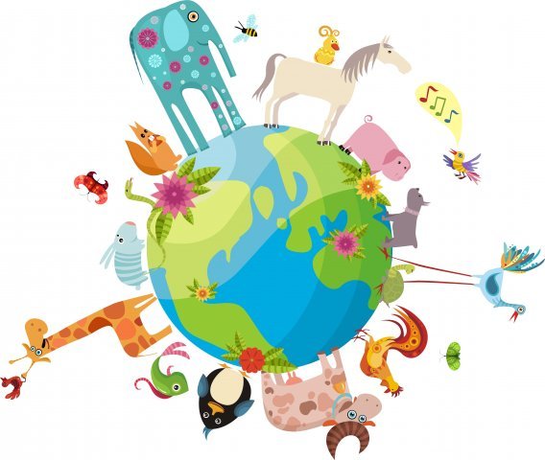
Our planet is amazingly rich and varied. Amazing, not similar to each other creatures live in different parts of the planet, and our task is to try to preserve this diversity as possible.
The world is full of animals
Some are big and tall
Some are strong and dangerous
Some are cute and small
.
All creatures are amazing
Just like me and you
Help protect the animals
This is their world, too
Animals are wonderful
They’re beautiful to see
Help them live a happy life
Help them to be free
Notes:
Help them to be free

