Slide 1
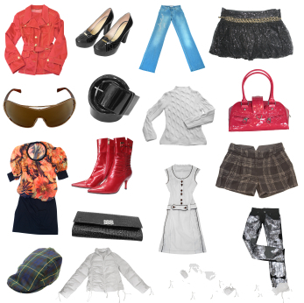
Clothes & Fashion
Презентация к уроку английского языка для 8 класса
2013 год

Slide 2
Items of clothes
Style, fashion
Material
Linen, modern, classy, tie, woolen, tight-fitting, suit, silk, dress, velvet, formal, casual, sweater, stylish, skirt, jeans, cotton, smart, elegant, T-shirt, leather, jacket, old-fashioned, sporty, trousers, nylon

Slide 3
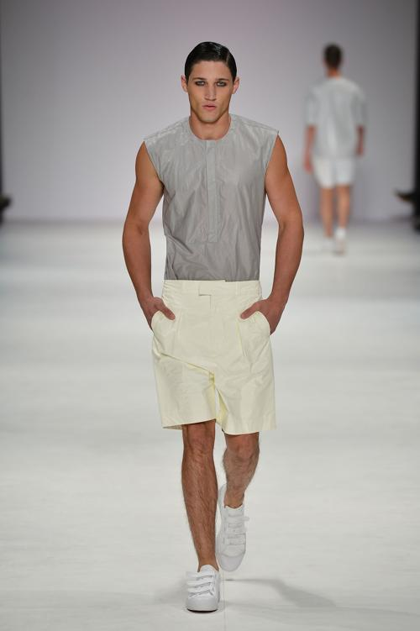
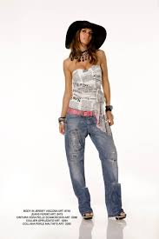
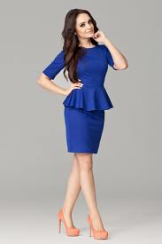
A B C

Slide 4
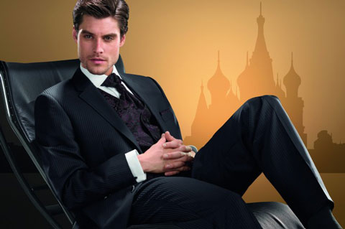
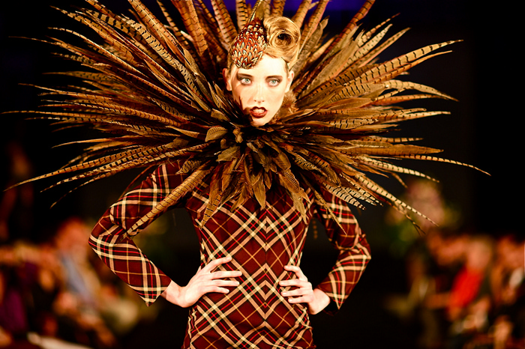
E
D

Slide 5
How important is style for you?
1. How would you define your own style in clothes?
a) cool- I like the latest fashion
b) smart- I like classy things
c) independent- I wear what I like
2. How much do you know about the latest fashion?
a) I’m well-informed
b) I know something
c) I haven’t got a clue!
3. What do you do when you hear about a new thing?
a) go straight out to the shops
b) think about it first
c) usually ignore it
4. Is it important to spend a lot of money to be stylish?
a) not at all
b) quite important
c) extremely important

Slide 6
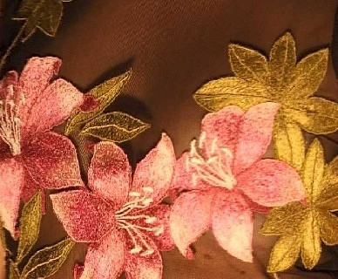

СИНКВЕЙН
clothes
bright, fashionable
to wear, to suit, to go with
a way to express your individuality
Image

