Slide 1
Virtual reality: significance in the modern world
Выполнила: Костылева Анна ученица 9 а класса
Научный руководитель: Алексеева И.В.
учитель английского языка

Slide 2

Main issues and purposes
Is virtual reality a step into the future or just an unsuccessful trick?
What kind of advantages and disadvantages does it have?
What is the role of the
USA in the formation
of virtual reality?

Slide 3
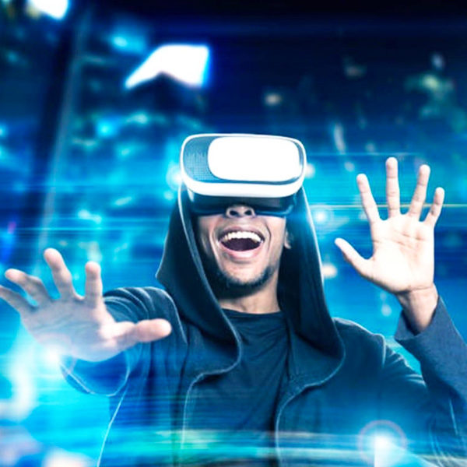
What is virtual reality
Virtual reality is a portal into any different world which can be created by human. It provides us with the opportunity to be fully immersed into various kinds of artificial environments.

Slide 4
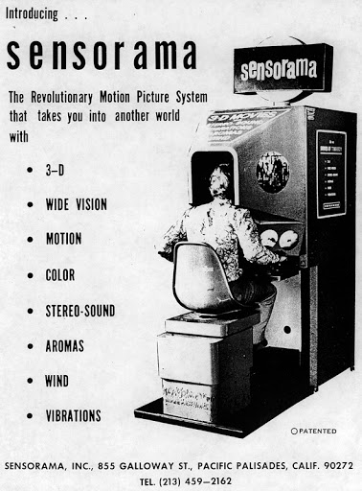
The history of virtual reality.
US significance in its development
In 1957 American cinematographer Morton Heilig invented a device called Sensorama. Вasically it’s a box you could stick your head in, watch a movie and have all of your senses stimulated

Slide 5
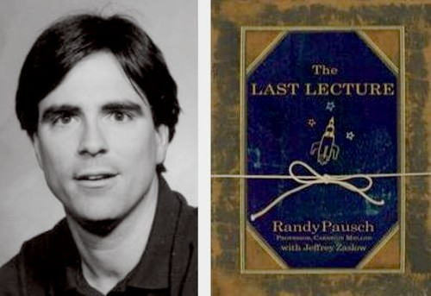
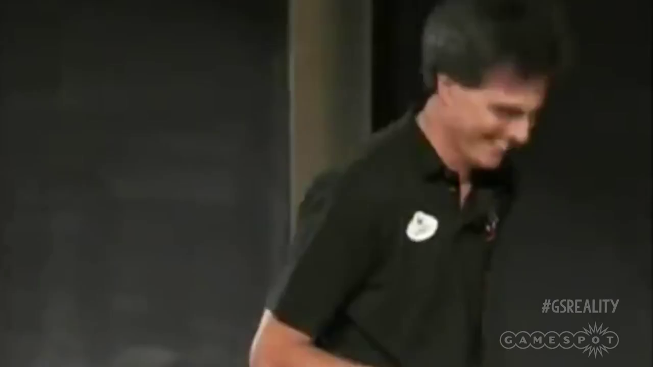
Randy Pausch

Slide 6
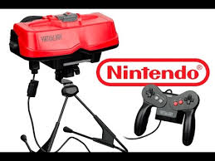
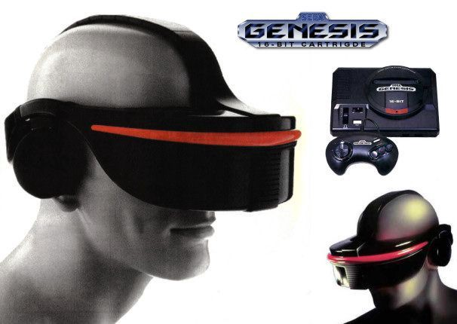
The first commercially available systems
Nintendo Virtual Boy Sega Genesis helmet

Slide 7
Impact on people. Advantages and disadvantages
Virtual reality can be a great asset for most of the existent fields of activity but it can also be a huge disadvantage
Pros | Cons
Better than reality | Feeling of worthlessness
Can be used in various fields | Replacing real life communication
Users have awesome experiences | Negative mental impact on a person
Gives opportunities to study, work and play | Users addict to the virtual world
Personal contact with user | Harm to interpersonal relationships between people
Provides any kind of information | People become distracted in real life

Slide 8
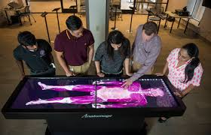
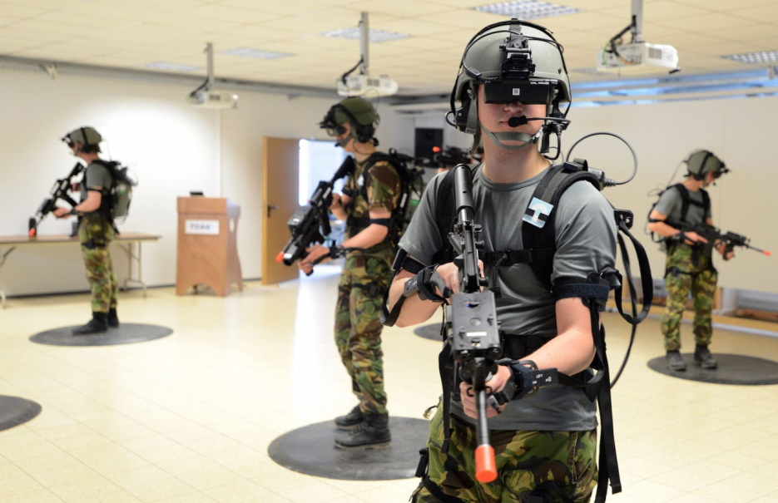
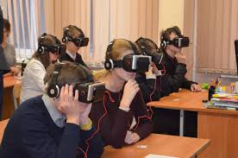
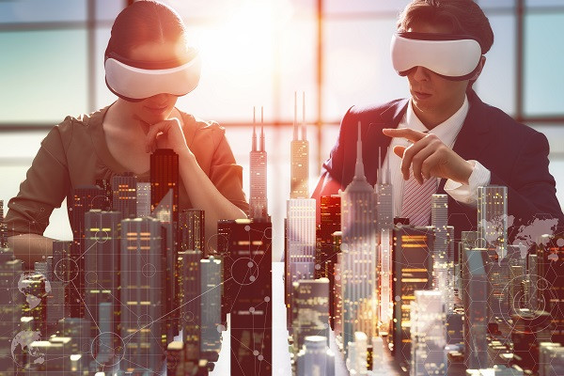
Various kinds of application on the example of the USA

Slide 9
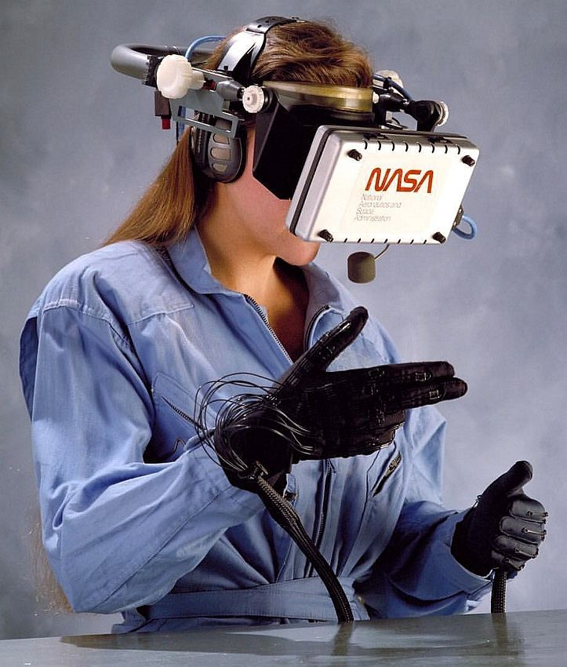
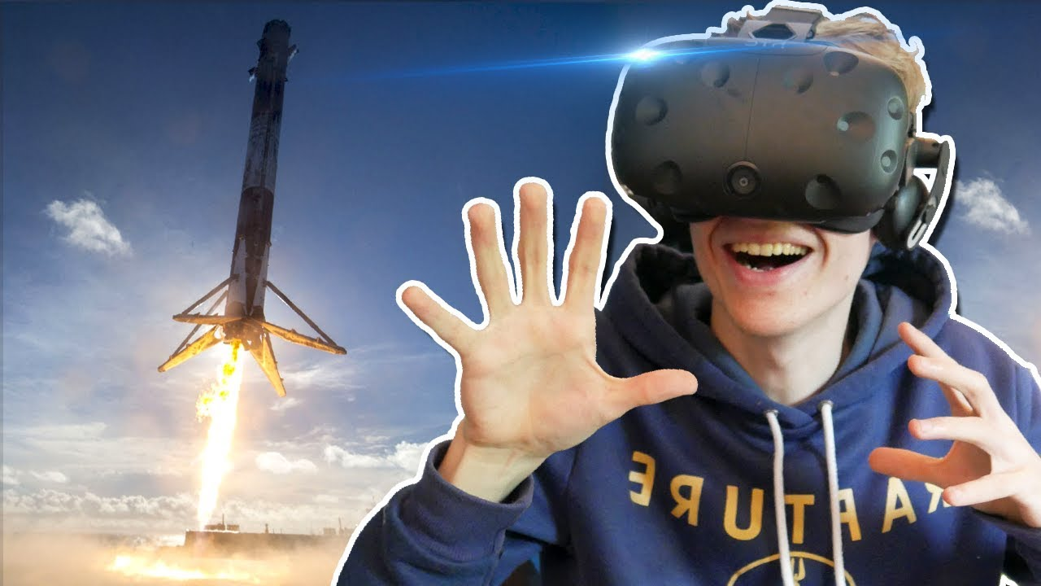
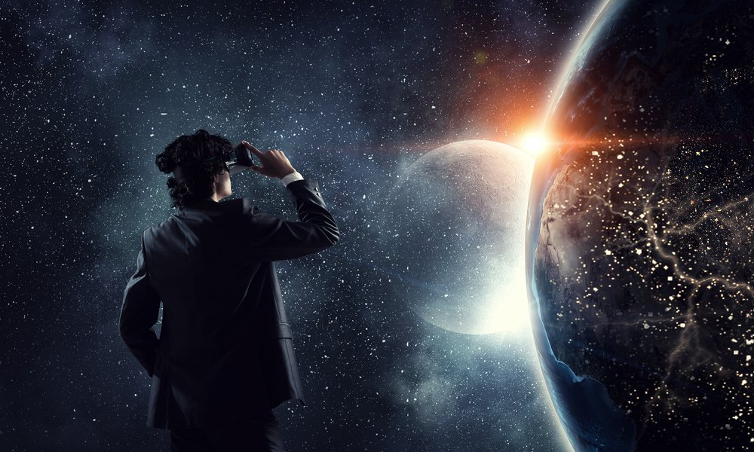
VR in space exploration

Slide 10
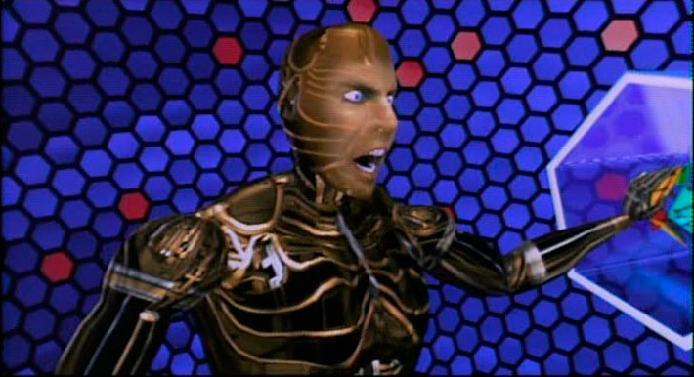
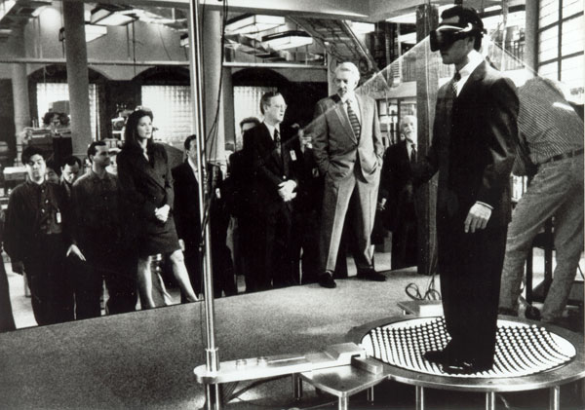
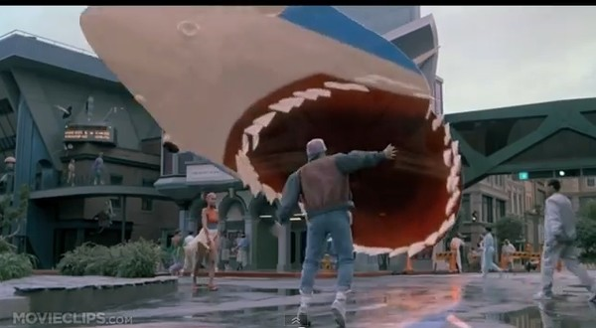
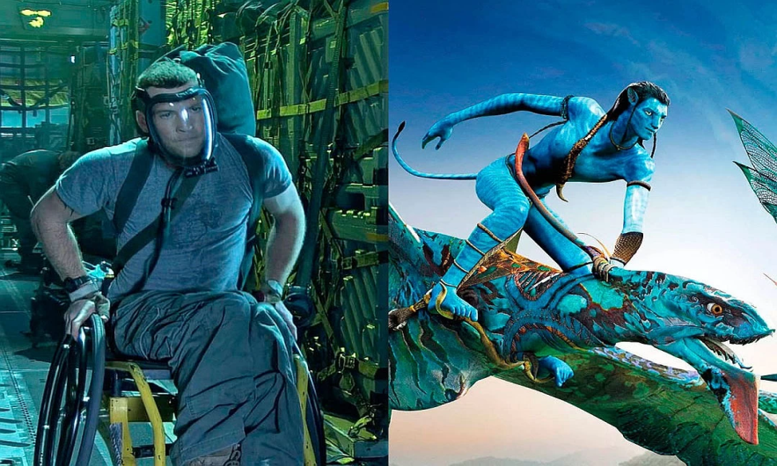
Future of virtual reality in the USA filmography
The Lawnmower Man (1992) Disclosure (1994)
Back to the future 2 (1989) Avatar (2009)

Slide 11
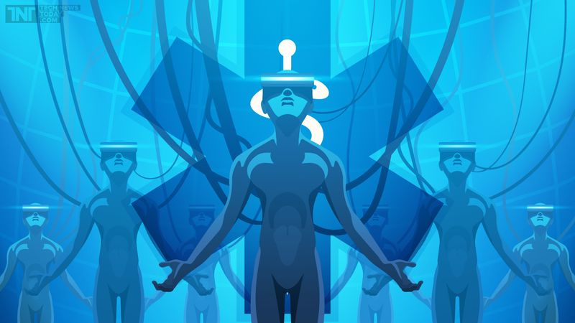
Conclusion

Slide 12
Thank you for your attention!

