Slide 1
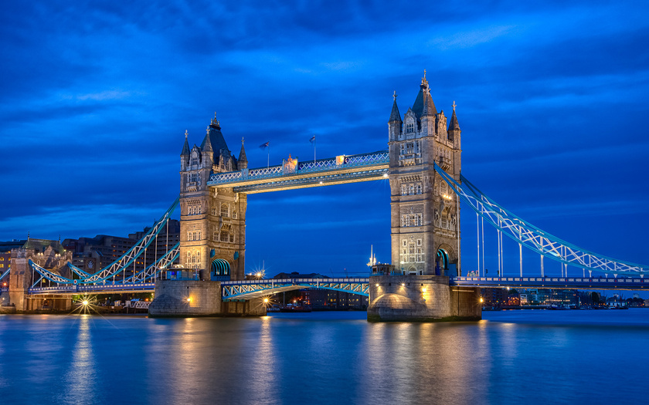
The River Thames as a museum of Englishness
Муниципальное бюджетное общеобразовательное учреждение «Школа №41»
Выполнила: учащаяся 6 В класса
Храмцова Ирина
Научный руководитель:
Учитель английского языка
Алексеева И.В.
2017 год

Slide 2
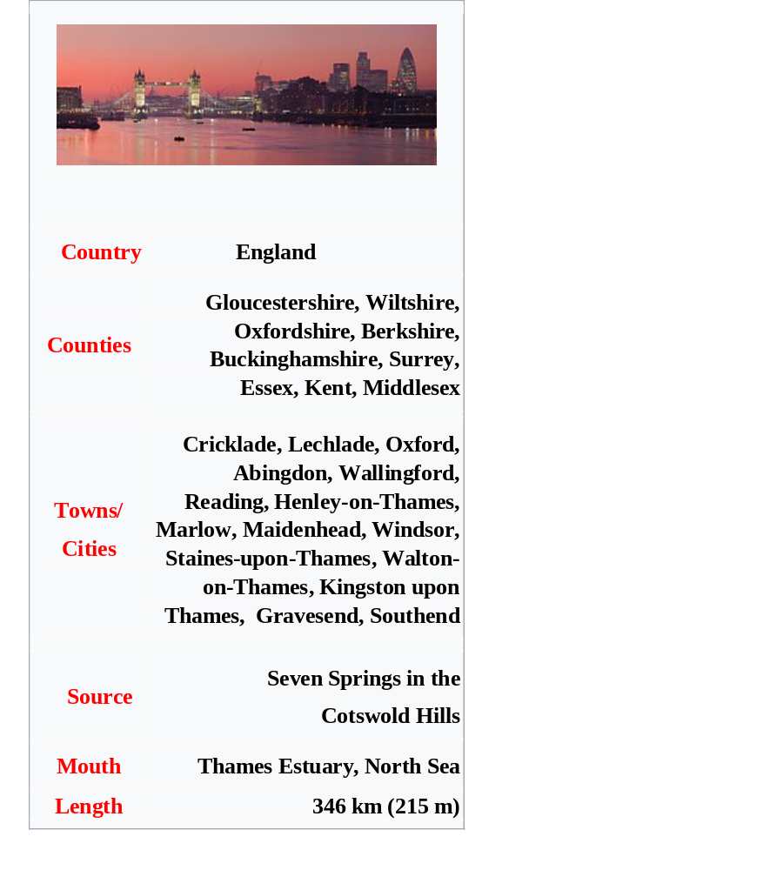
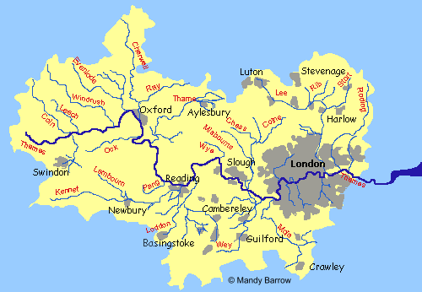
Location of the river Thames

Slide 3
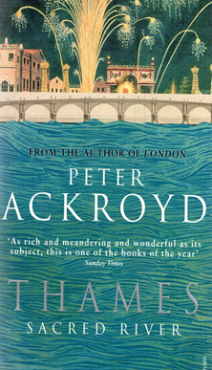
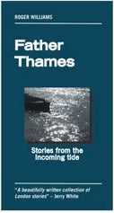
The river runs through the language
Thames is an old name
Celtic tam, meaning smooth or wide-spreading and
isa or esa are both versions of a Celtic root word meaning running water;
from Sanskrit tamasa, or «dark»;
the syllable teme may indicate darkness,
in the sense of holy or sacred fearfulness.

Slide 4
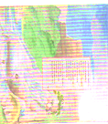
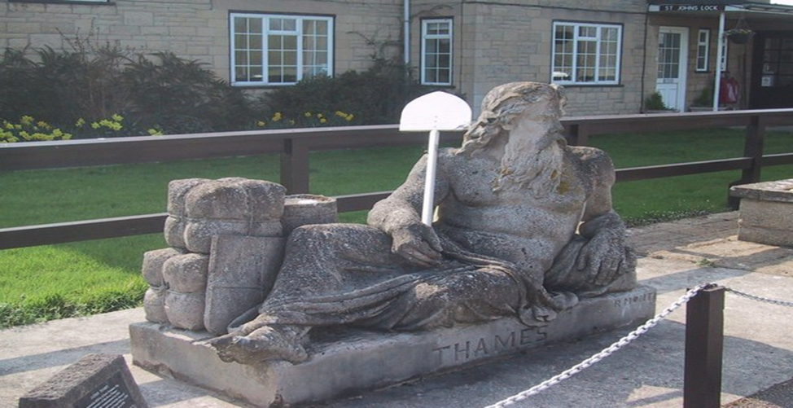
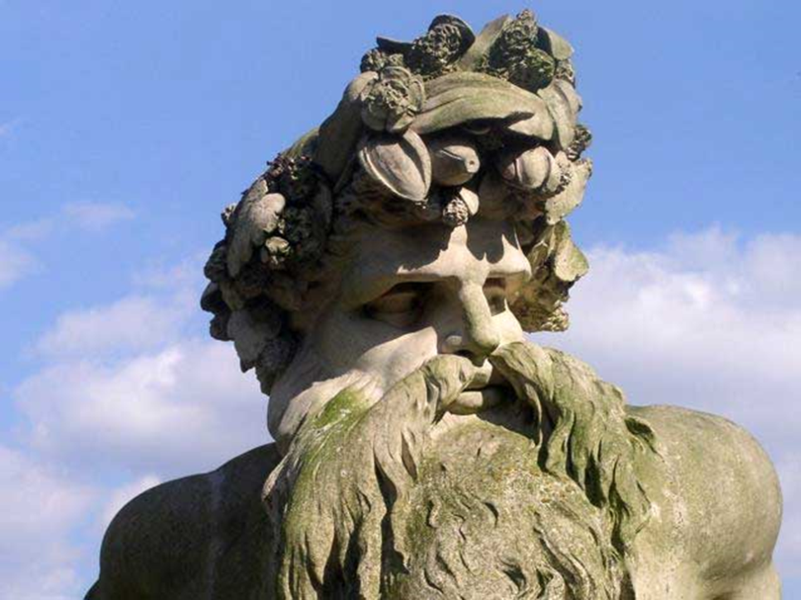
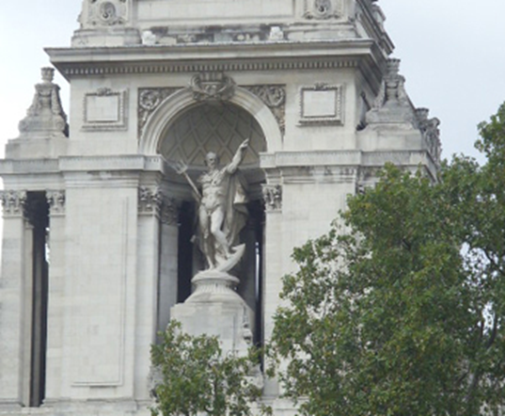
Old Father Thames

Slide 5
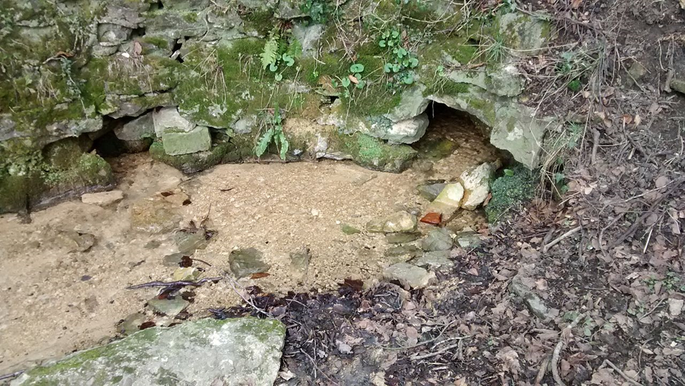
The river Thames is very old, it is over 170 million years

Slide 6
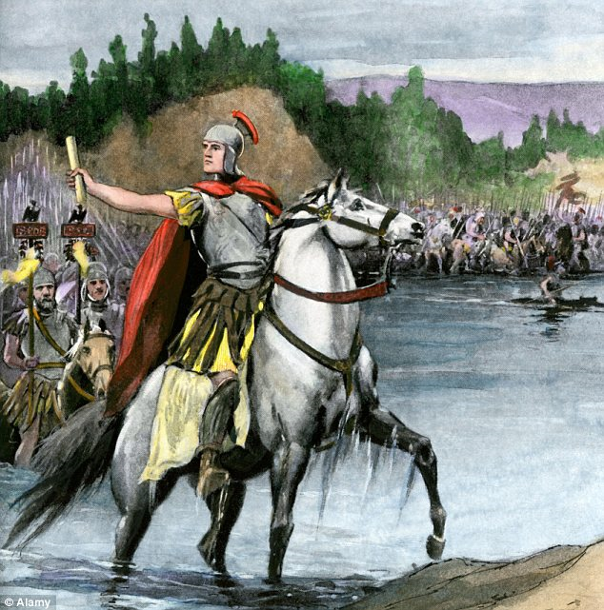
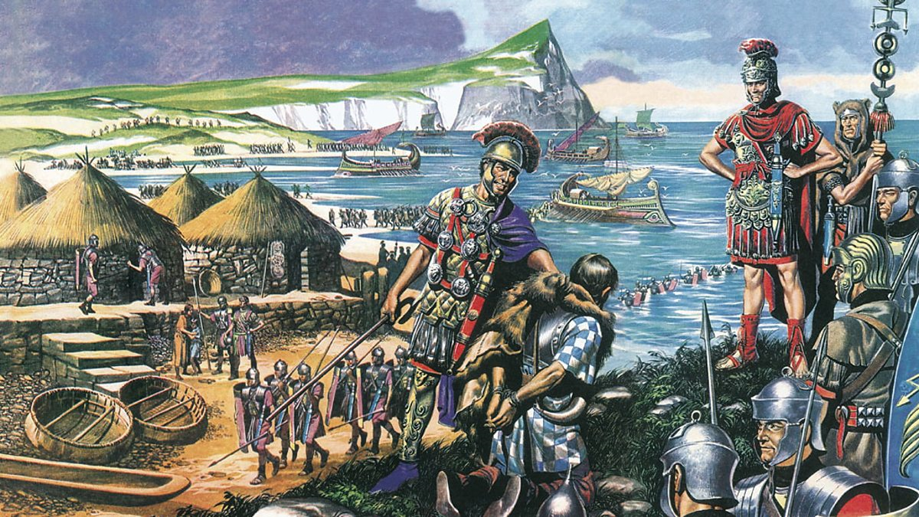
Romans on the Thames the river of military and commercial power

Slide 7
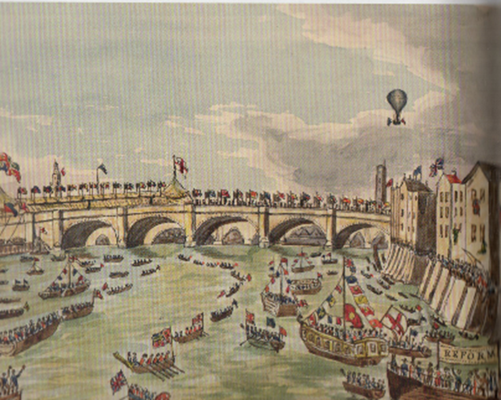
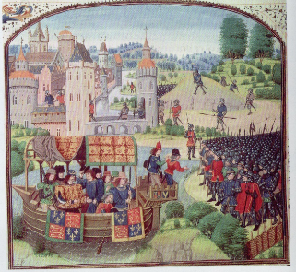
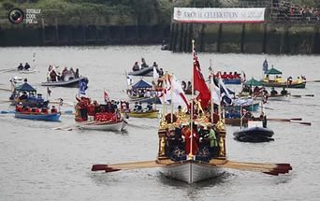
The Thames in the 16th century the river of royal pomp and procession

Slide 8
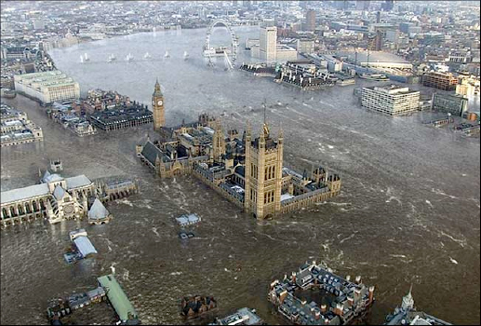
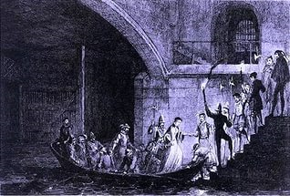
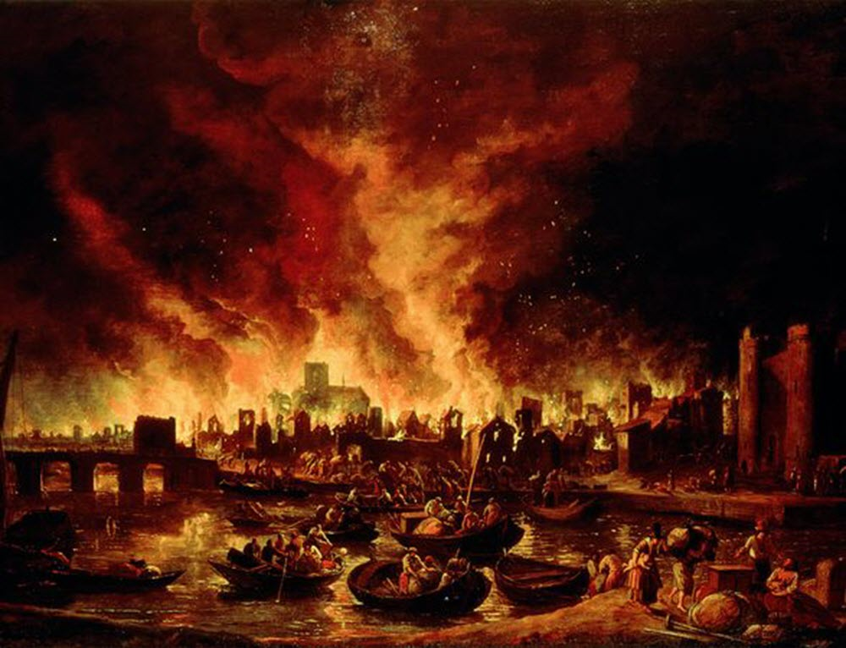
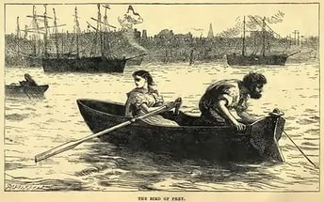
The river of death

Slide 9
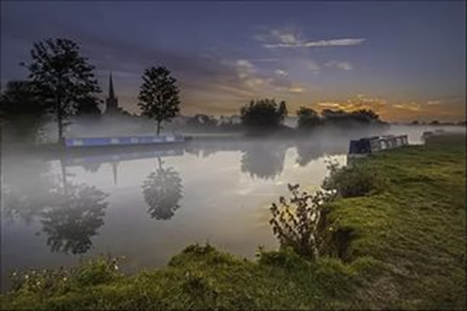
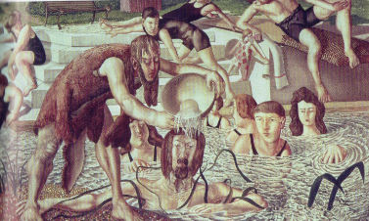
Philosophical aspects of the river Thames
Belief in spiritual forces
The Quality of timelessness
Reflections encourage doubling and pairings
The emblem of redemption and renewal

Slide 10
Bridges on the Thames
London Bridge
Tower Bridge
Millennium Bridge
Greenwich Railway viaduct
New Bridge
The bridges of the Thames are its most enduring human features.
There are 106 pedestrian bridges, also 9 rail bridges and 19 road bridges.

Slide 11
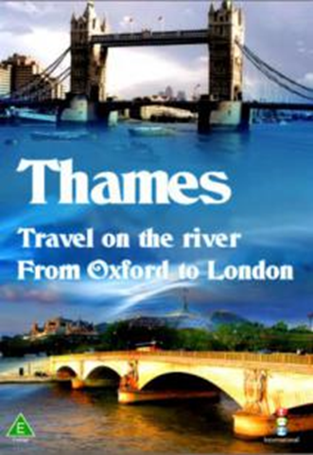
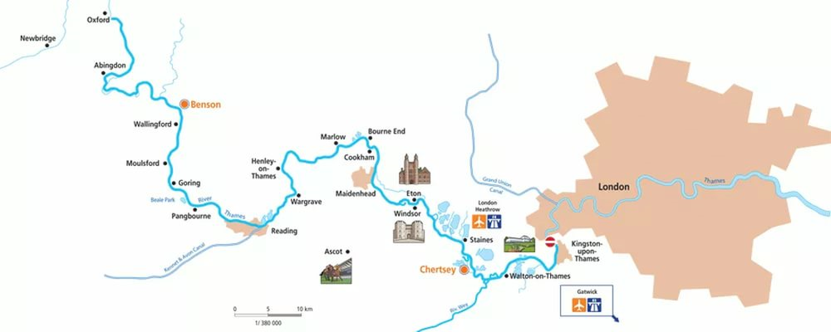
A trip on the river Thames

Slide 12
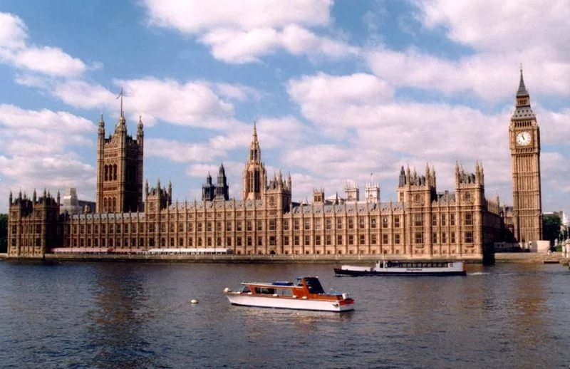
Thank you for your attention!

