Slide 1
artists of the 19th century
Prepared: students of 9 B class:
Dozorova Elizaveta
Matveicheva Darya
Shumilo Darya
Teacher: Irina Vyacheslavovna Alekseeva
20.03.2018

Slide 2
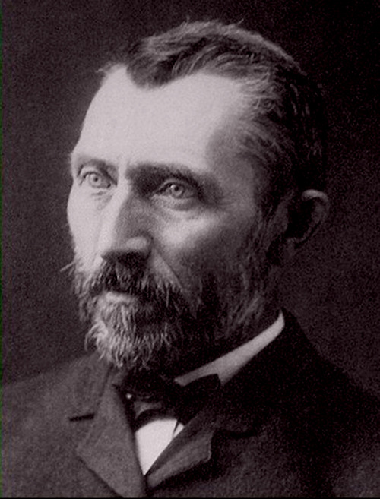
Vincent Willem Van Gogh
Vincent Willem Van Gogh was born in Netherland in the 19th century. He is one of the most famous of Netherlander painters of this time. His famous pictures there are:"Van Gogh's bedroom in Arles",Museum d'Orsay, Paris, France.;"Walk of prisoners.",Moscow Pushkins museum.

Slide 3
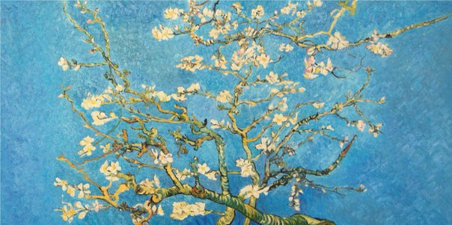
The blossoming almonds branches
I'm going to tell you about "The blossoming almonds branches." To my mind its the most beautiful picture of Vincent Willem Van Gogh. I can look at it for many time.
On January 31, 1890 Teo van Gogh has written to Vincent about the birth of the son who was called Vincent Willem in honor of the uncle. Vincent van Gogh has at once turned to work over a picture which he intended to present to the younger brother

Slide 4
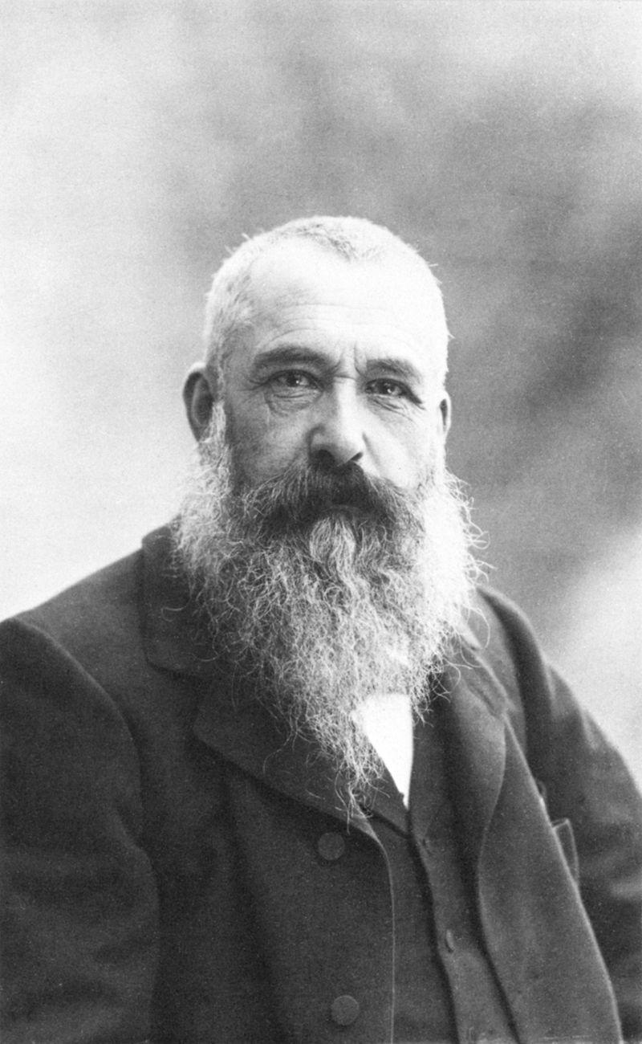
Oskar Claude Monet
Oskar Claude Monet was born in France in the 19th century. French painter, one of founders of impressionism. He is one of the most famous of France painters of this time. His famous pictures there are:« Kaputsinok Boulevard in Paris", 1873; "Rocks in Bel-or", 1886, "Morning by the sea", 1881.

Slide 5
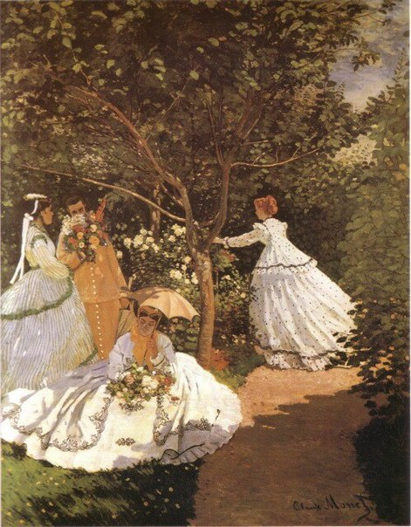
Woman in garden
I'm going to tell you about "Woman in garden ". To my mind its the most beautiful picture of Claude Monet. I can look at it for many time.
His friends, coming to him on a visit to the quiet estate, brought to him the most beautiful flowers from different corners of the world therefore quite rare copies grew in a garden at him. Seasonally the garden changed the shades, than very much pleased the creator. He has found inexhaustible inspiration in the garden

Slide 6
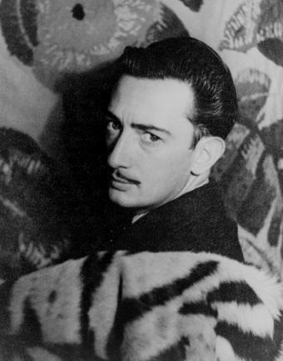
Salvador Dali
Salvador Dali was born in Spain in the 19th century. He is one the most famous of Spanish painters of this time. Among his famous pictures there are:"The woman with the head from roses";"Constancy of memory";"Metamorphosis Narcissa".

Slide 7
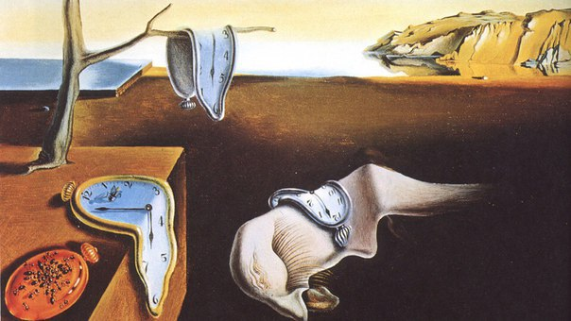
Constancy of memory
I'm going to tell you about "Constancy of memory."To my mind its the most beautiful picture of Salvador Dali. I can look at it for many time. The idea of work has come to Dali in hot summer day.After Dali's food I have noticed that cheese melts from a heat, becomes fluid.The artist had had a desire to write a landscape with the melting hours.

Slide 8
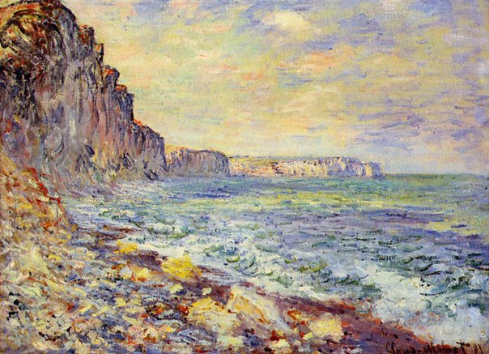
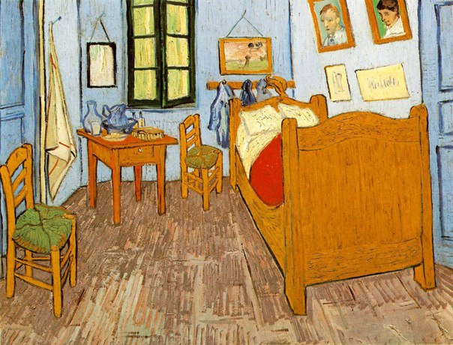
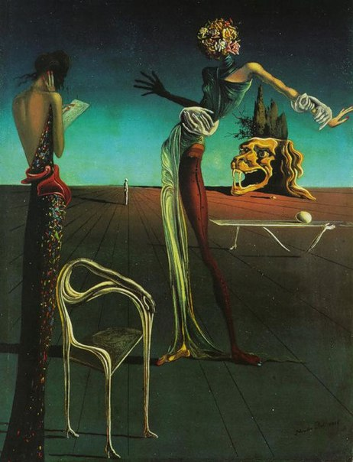
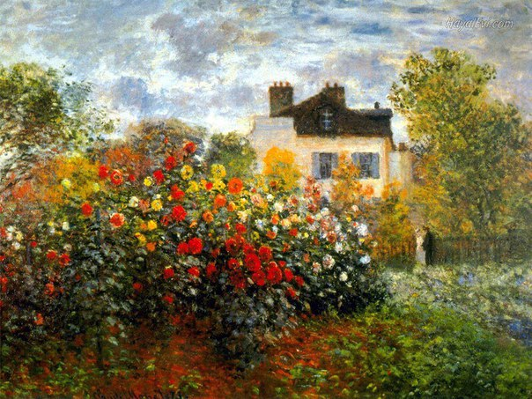
Thanks for your attention

