Slide 1
My favourite kind of transport.
Trains.
Lukoyanova Anastasiya
Class 10 A
School №41

Slide 2
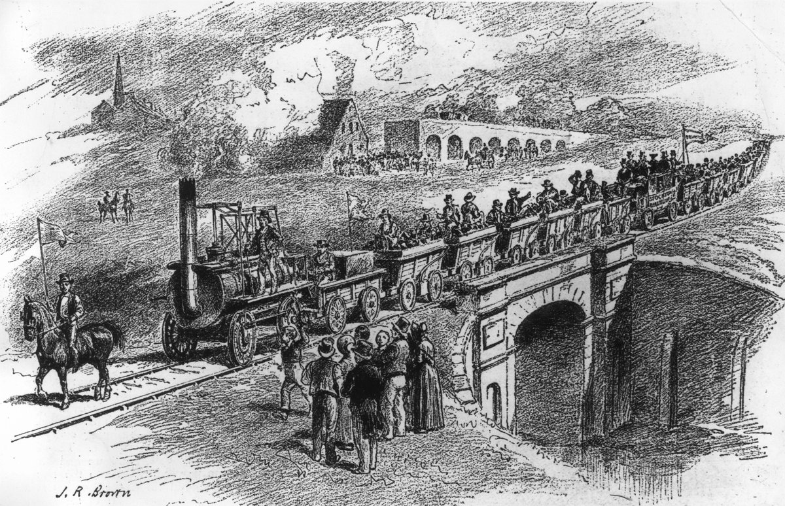
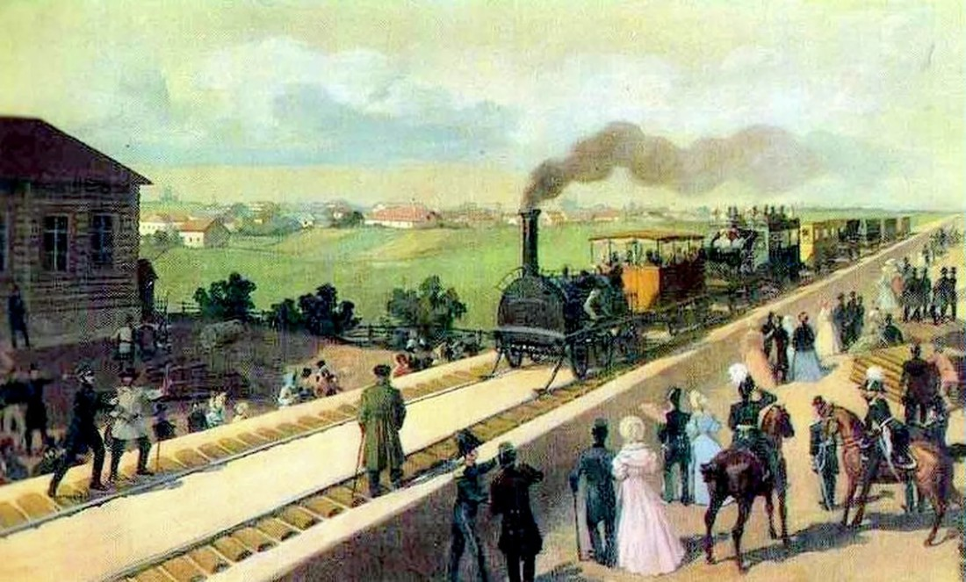
History of the train
In 1825, on the 27th of September the first public was opened.
In 1837, on the 30th of October Tsarskoe Selo Railway - the first public railway in Russia - was opened.
Railway from Stockton to Darlington Tsarskoe Selo Railway

Slide 3
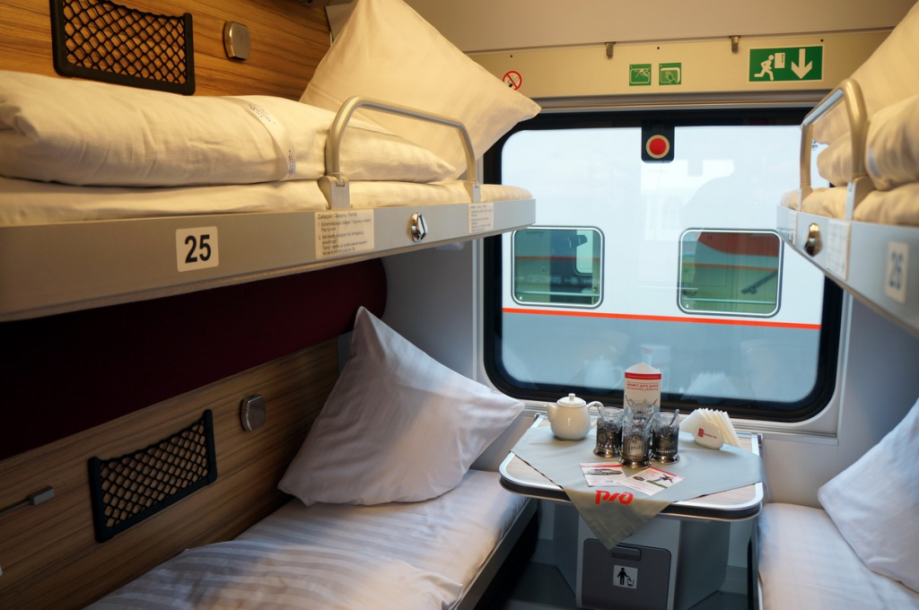
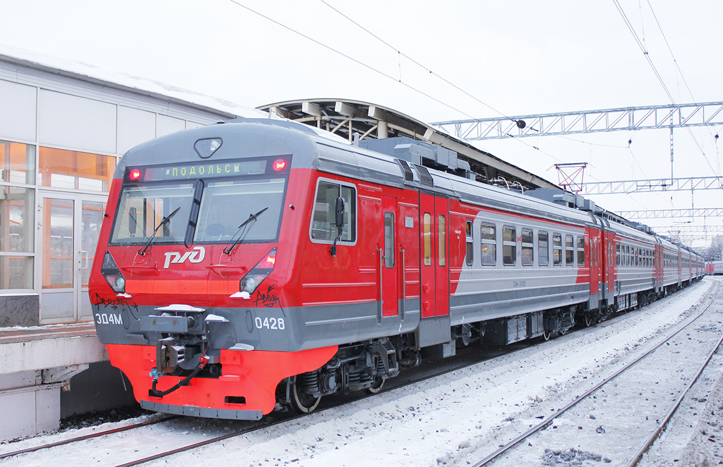
Types of trains and carriges in Russia
Types of carriges:
Reserved seats (3rd class)
Coupe (2nd class)
Soft-seated (1st class) wagons
Types of trains:
1. Year-round modern trains
2. Classic express trains (Russian Railways)
3. High-speed trains
4. Tourist trains

Slide 4
Advantages of travelling by train
Doesn’t depends on natural conditions
Large lifting capacity
Low cost price
Large and convenient route network
Most of the train stations are located in the city center.
You can take unlimited food and drinks with you.

Slide 5
Disadvantages of travelling by train
Long travel time
Poor condition of carriges
Small personal space
«Disadvantages of reserved seats»

Slide 6
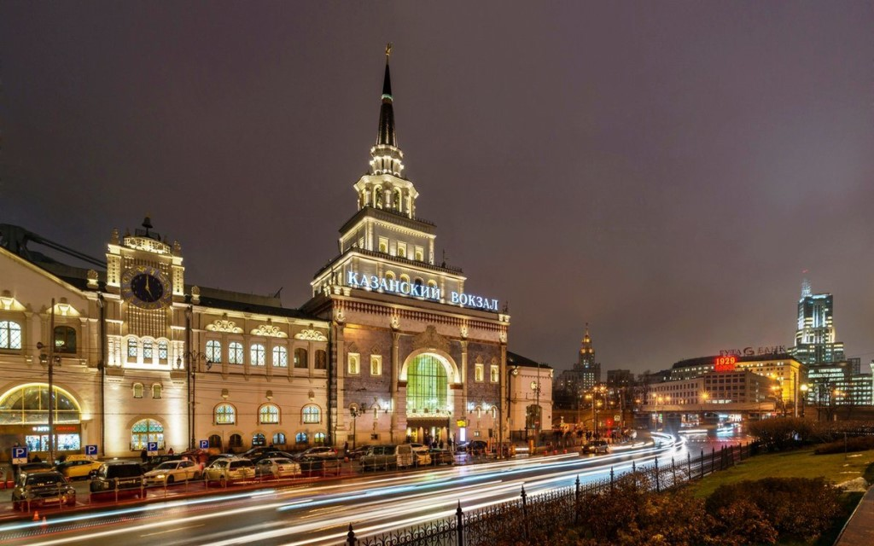
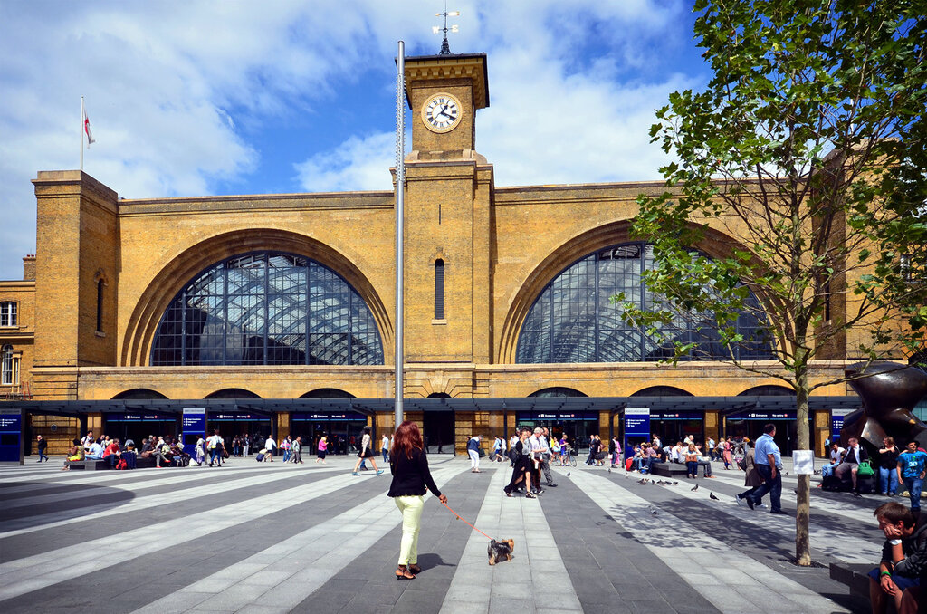
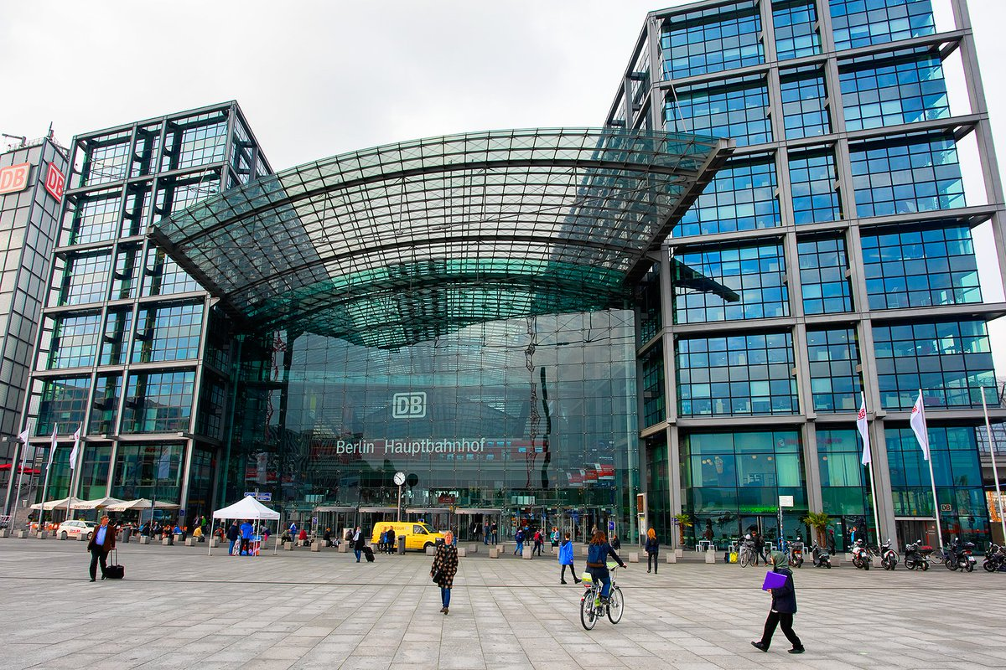
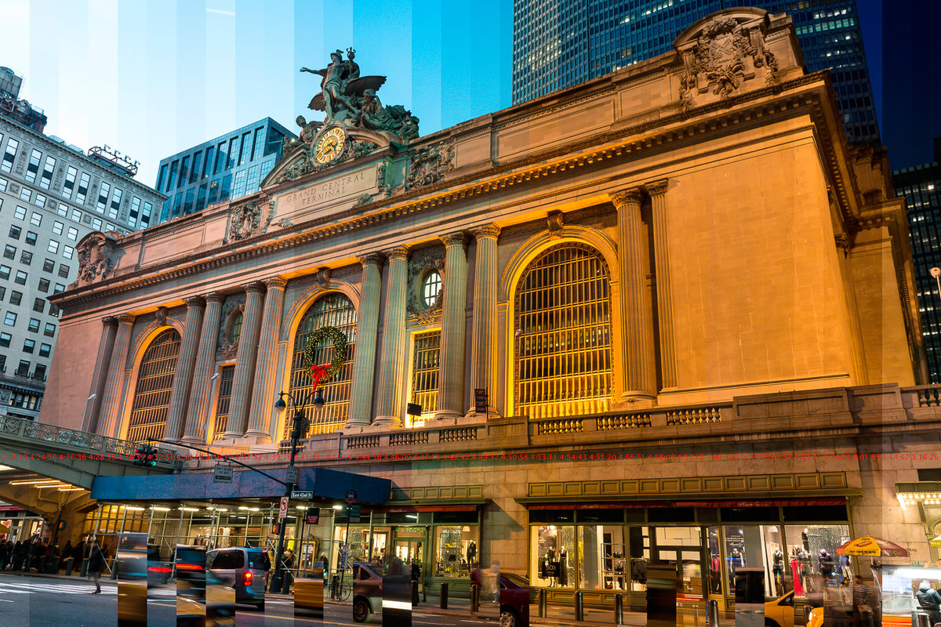
Railway stations in Russia and in other countries

Slide 7
Thank you for your attention!

