Slide 1
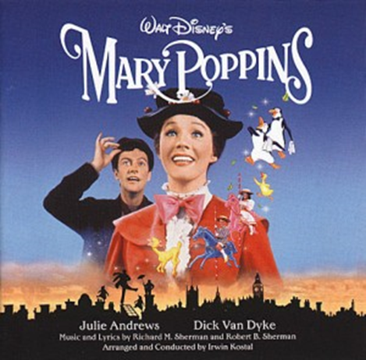

Slide 2
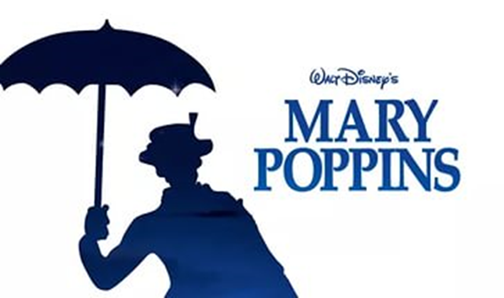
Mary Poppins is a 1964 American musical fantasy comedy film directed by R. Stevenson and produced by Walt Disney.
The film received five Academy Award nominations:
Best Actress, Best Film Editing, Best Original Music Score, Best Visual Effects, and Best Original Song.
In 2013, the film was selected for preservation in the United States National Film Registry by the Library of Congress as being "culturally, historically,
or aesthetically significant".

Slide 3
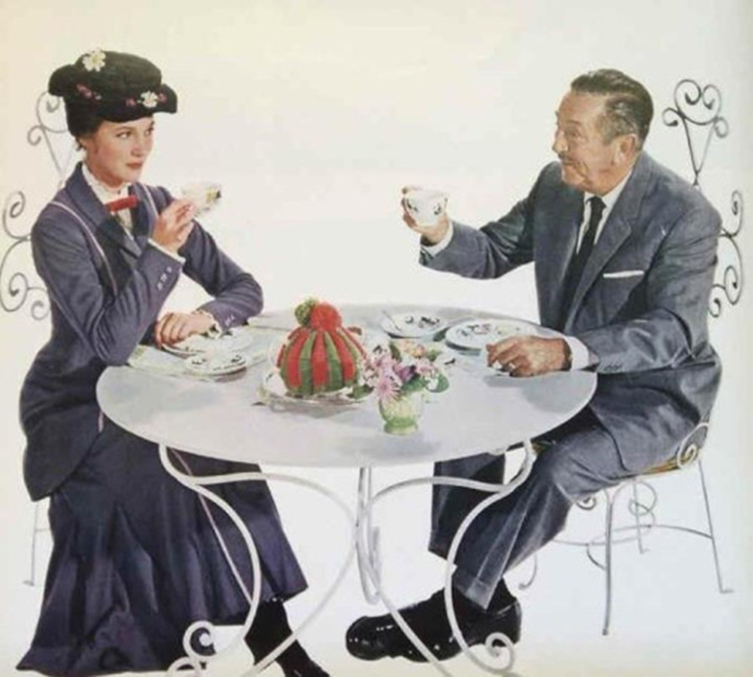
Mary Poppins is widely considered to be Walt Disney's "crowning achievement", being his only film to garner a "Best Picture" nomination at the Oscars in his lifetime.

Slide 4
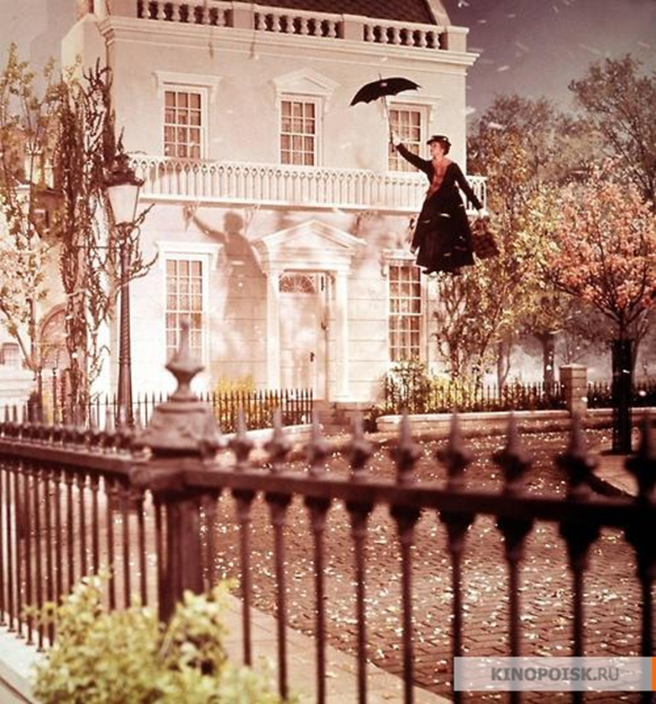
The Perfect Nanny
Wanted a nanny for two adorable children
If you want this choice position
Have a cheery disposition
Rosy cheeks, no warts!
Play games, all sort;
You must be kind, you must be witty
Very sweet and fairly pretty
Take us on outings, give us treats
Sing songs, bring sweets.
Mike and Jane Banks

Slide 5
