Slide 1
Machu Picchu
Made by Morozkina Aleksandra 10 «А»

Slide 2
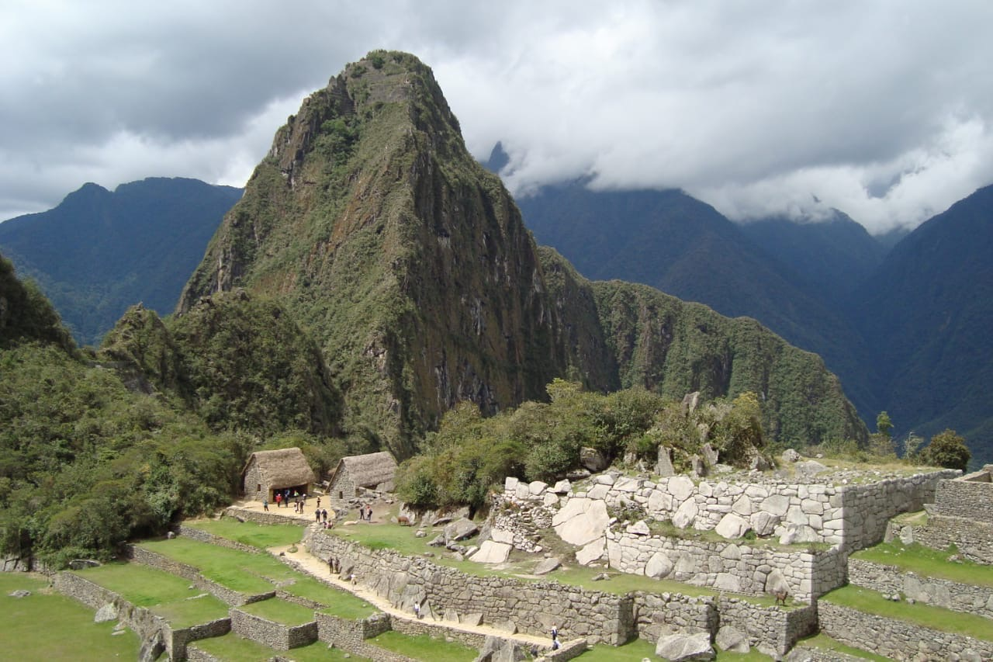
What is «Machu Picchu»?
Machu Picchu is the ruins of a small city built in the 15th century by the Inca Indians. It is found high in the Andes mountain range in central Peru, South America.

Slide 3
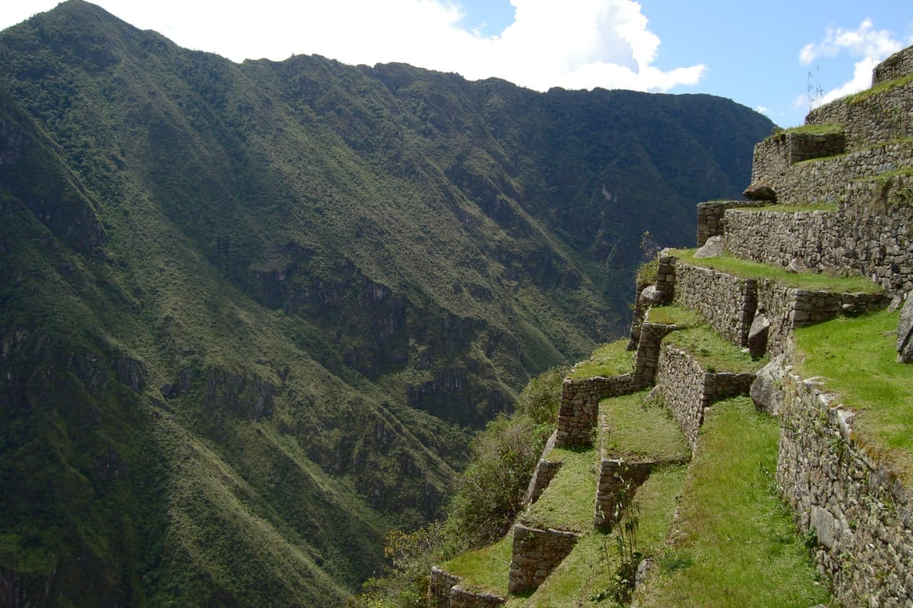
History of this city
When the Spanish invaded Peru, the Incas left Machu Picchu. It was not known to the Spanish during the colonial period and remained unknown to the outside world until American historian Hiram Bingham brought it to international attention in 1911.

Slide 4
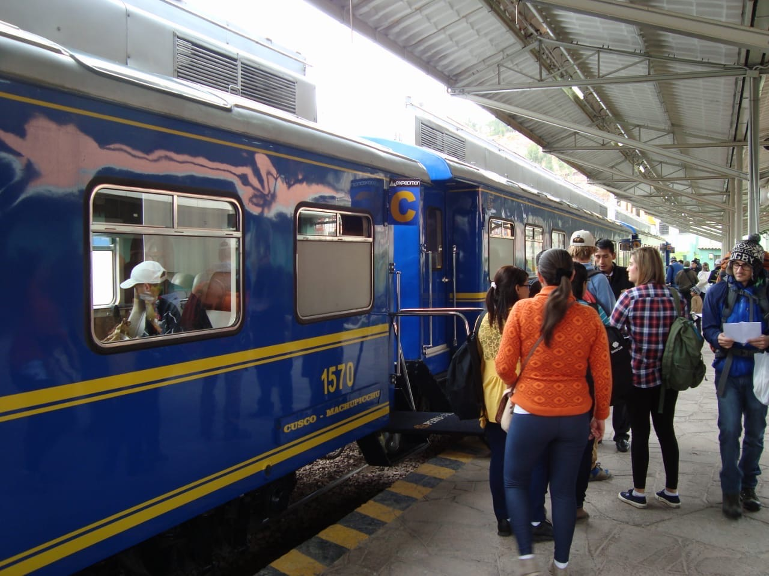
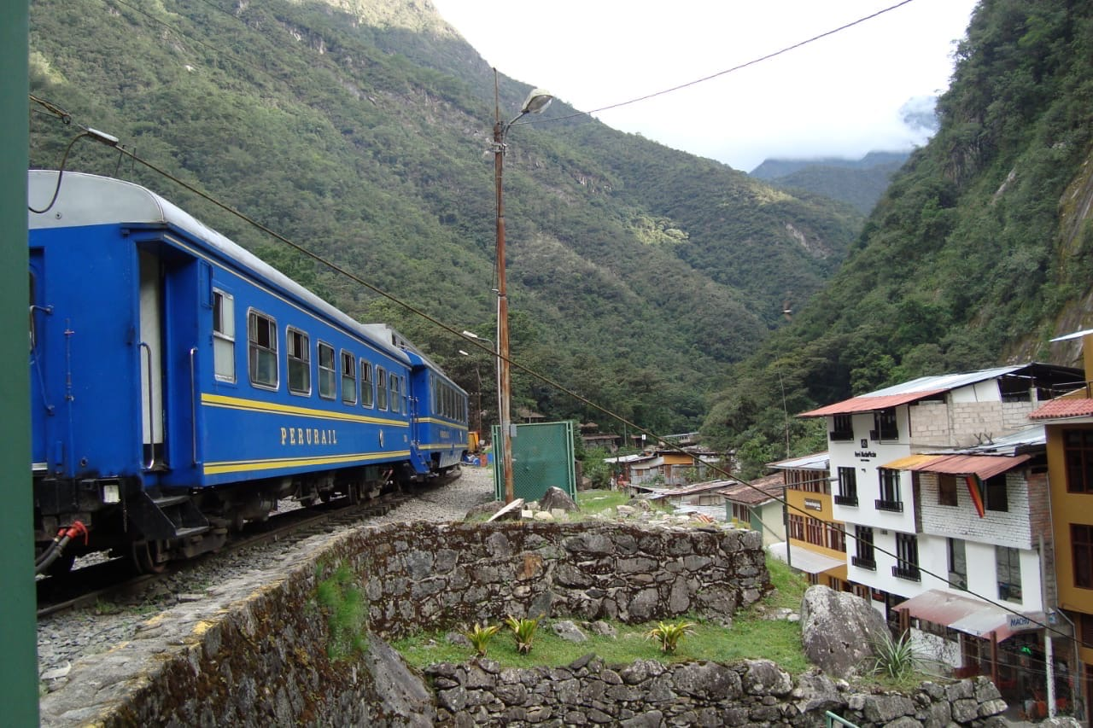
Roads and transportation
The Inca road system included a route to the Machu Picchu region. The people of Machu Picchu were connected to long-distance trade, as shown by non-local artifacts found at the site.

Slide 5
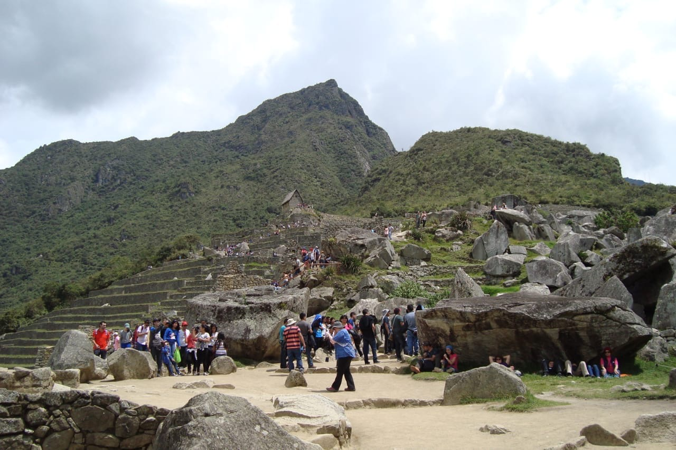
Tourism
Since its discovery in 1911, growing numbers of tourists have visited the site each year.
Tourist deaths have been linked to altitude sickness, floods and hiking accidents. UNESCO received criticism for allowing tourists at the location given high risks of landslides, earthquakes and injury due to decaying structures.

Slide 6
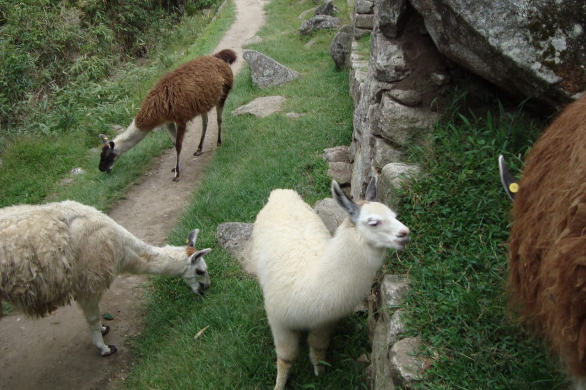
Interesting facts
Nobody knows the real name of the city these days. Machu Picchu is a nickname
In 2012, archaeologists discovered underground rooms. Many researchers propose a version that the lost gold of the Incas was kept there

Slide 7
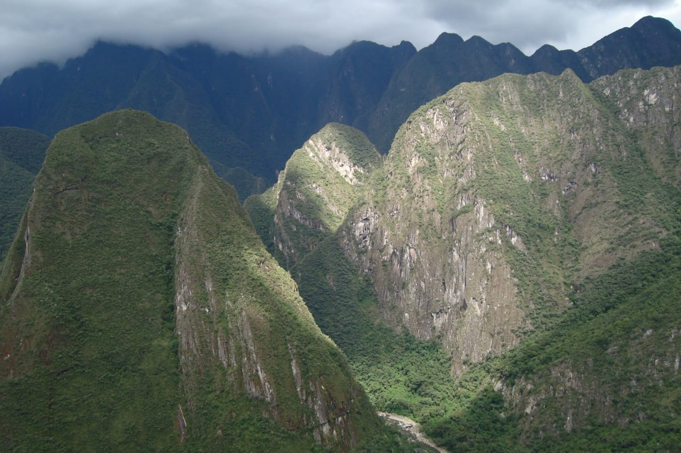
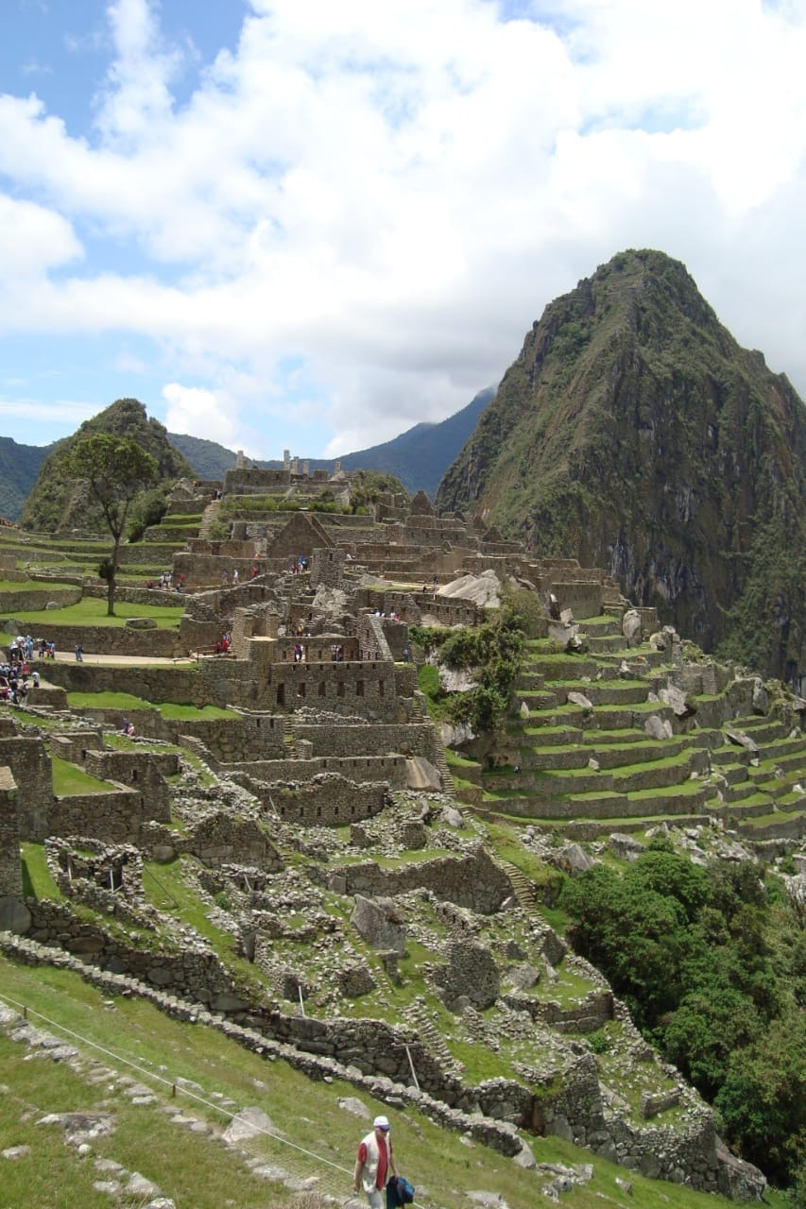
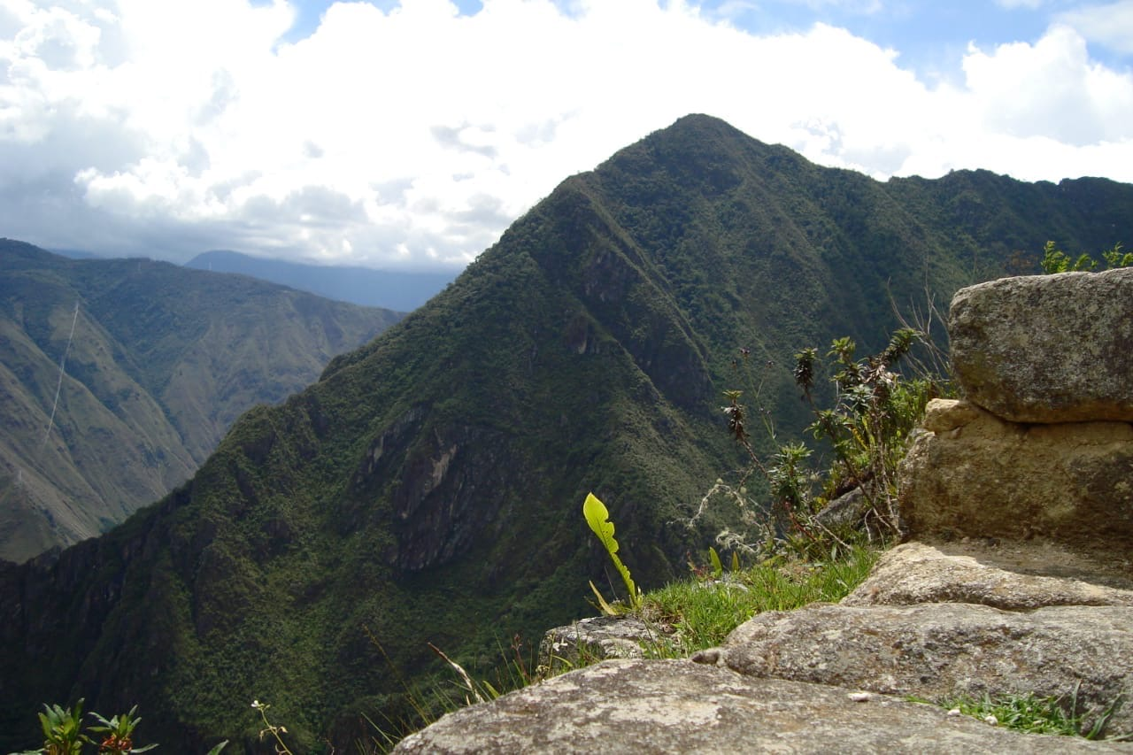

Slide 8
Thanks for your attention

