Slide 1

Kyoto
Tokyo
Trenina Elisaveta
Kostyleva Anna

Slide 2
Kyoto
-
Japanese capital of culture
京都

Slide 3
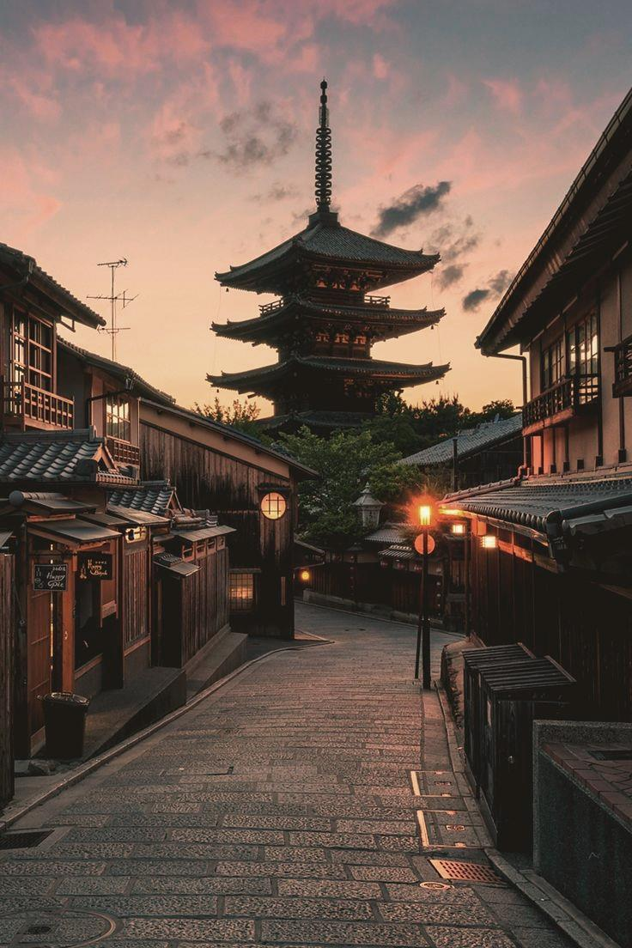
The city of Kyoto
Kyoto (京都, Kyōto) is the capital city of Kyoto Prefecture in Japan. Located in the Kansai region on the island of Honshu. As of 2018, the city had a population of 1.47 million. Kyoto is considered the cultural capital of Japan and a major tourist destination. Kyoto is also a center of higher learning, with Kyoto University being an institution of international renown.

Slide 4
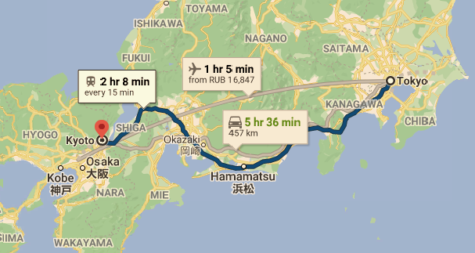
Far from the capital
By car
6 hours
By train
2 hours
(10 000₽)
By plane
1 hour
(9 000 – 11 000₽)

Slide 5
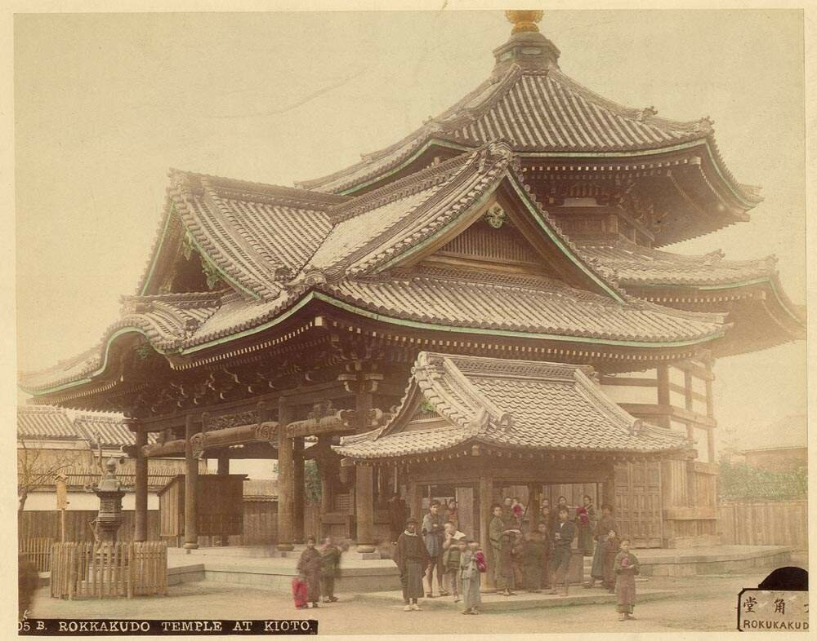
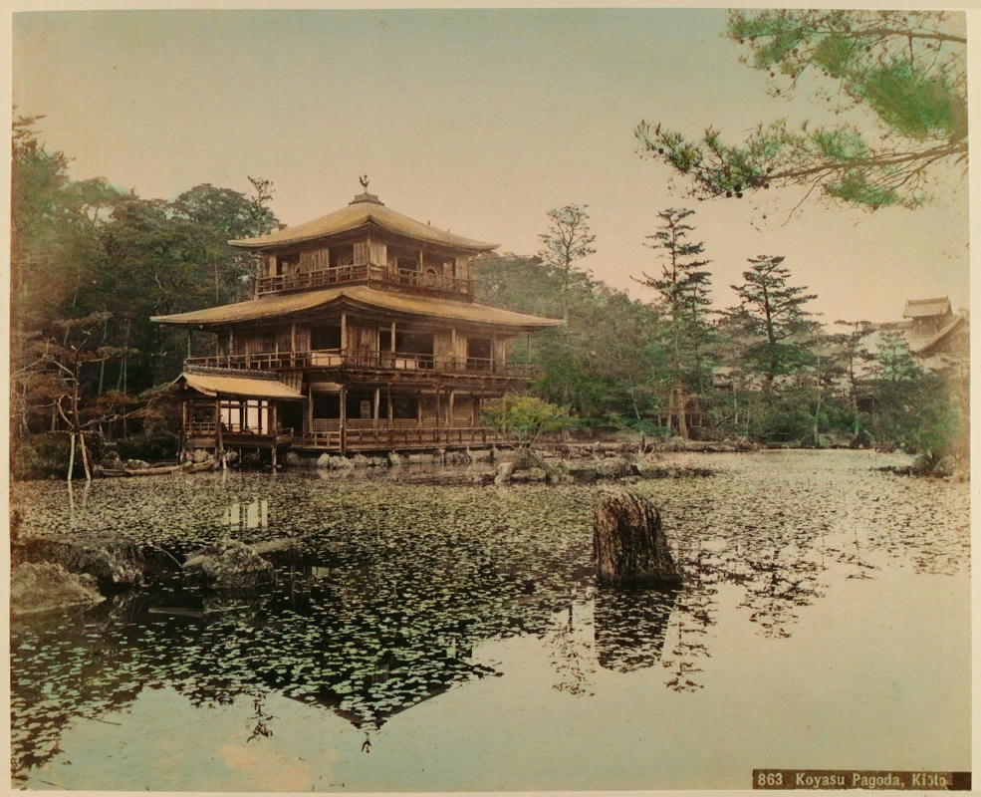
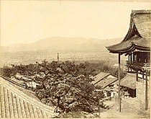
The city’s history
794 – the new seat of Japan's imperial court.
1869 - the court was relocated to Tokyo.
1467-1477 – The Ōnin War.
1939-1945 – World War II.

Slide 6
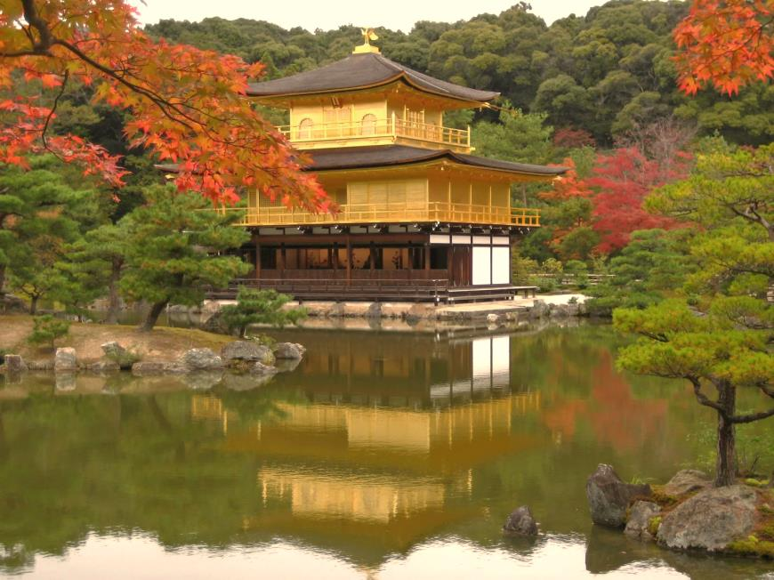
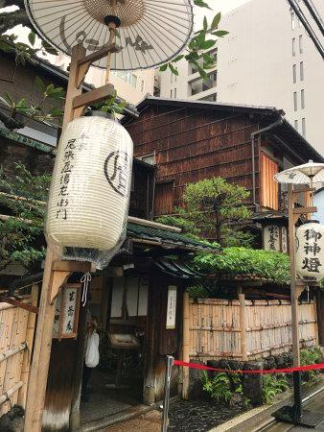
Specific features
Kyoto is an extremely religious city, there are 1600 temples.
Lots of tourist come here to see the temples, especially the Temple of the Golden Pavilion, Ginkaku-ji.
The oldest restaurant in Kyoto is Honke Owariya which was founded in 1465.

Slide 7
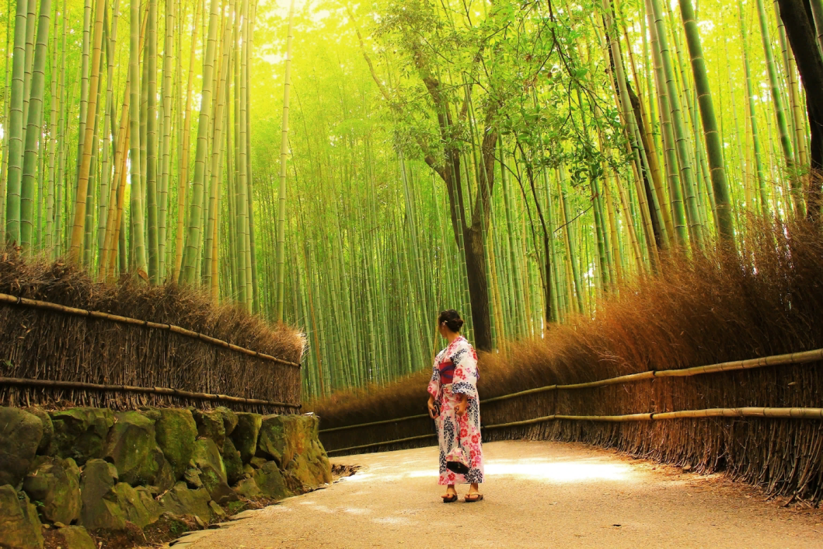
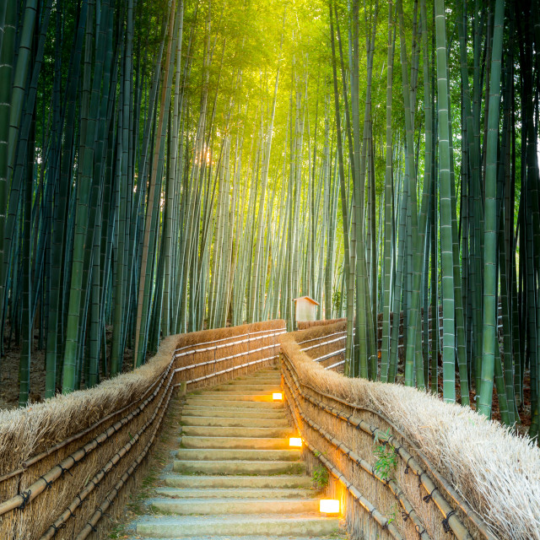
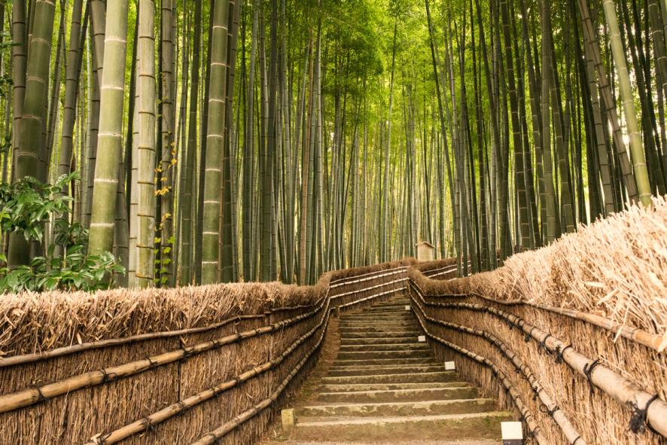
Arashiyama Bamboo Grove

Slide 8
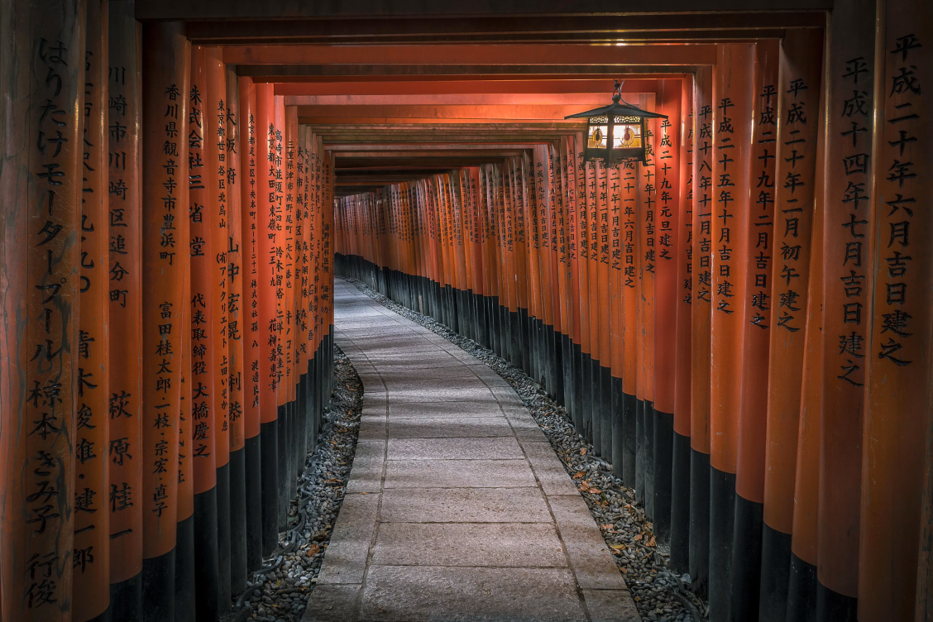
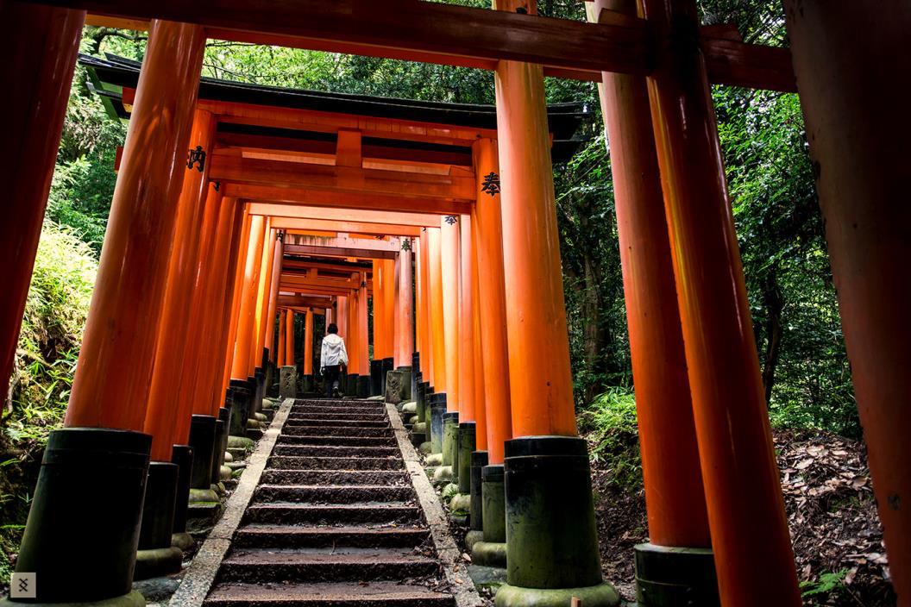
Fushimi Inari Shrine

Slide 9
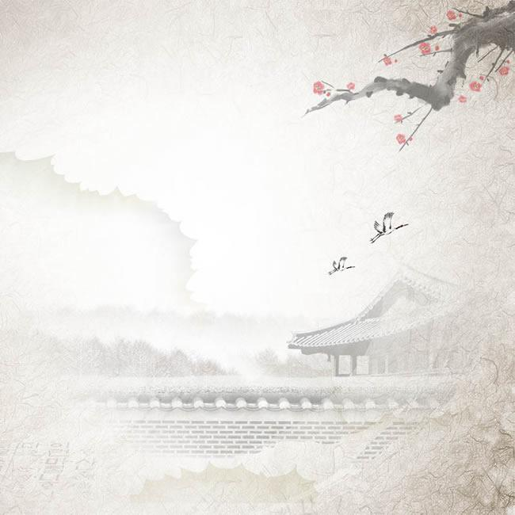
Tokyo
− the capital of Japan
東京

Slide 10
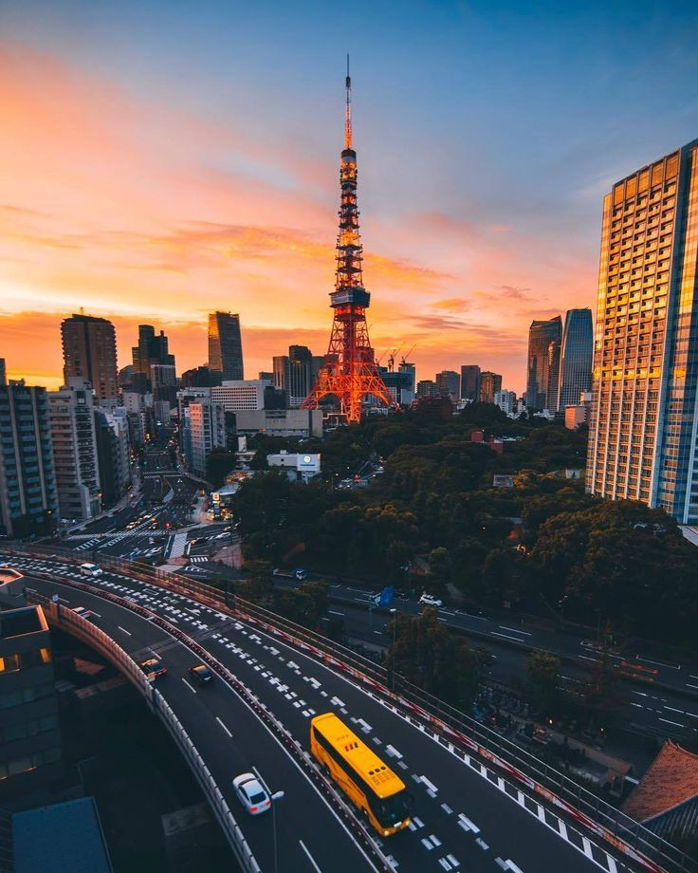
The city of Tokyo
Tokyo is the capital of Japan and largest city of the country with a population of about 8.3 million people. It is one of the 47 prefectures of Japan. It is situated on the eastern side of the main island Honshu and includes the Izu Islands and Ogasawara Islands. Tokyo is the seat of the Japanese government and the home of the Japanese Imperial Family.

Slide 11
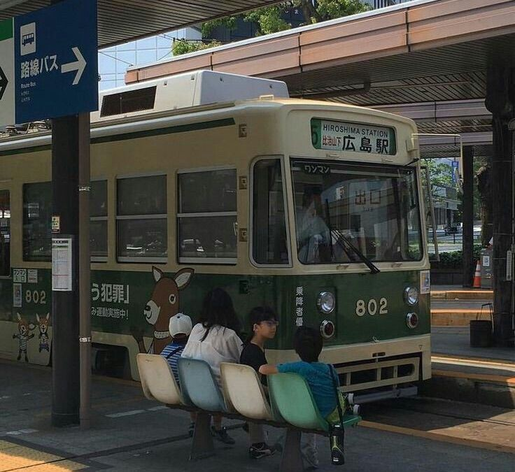
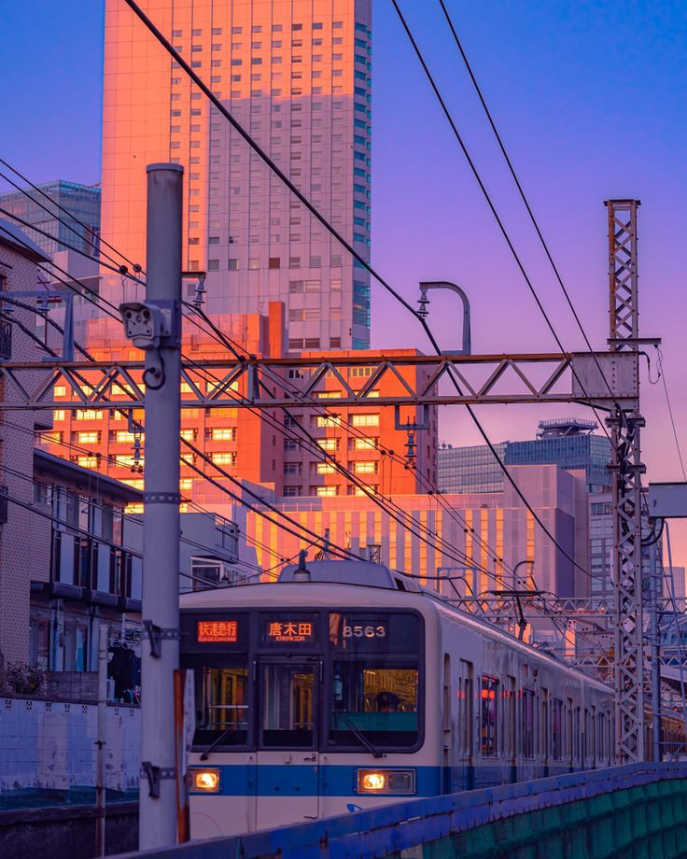
Best ways to get around

Slide 12

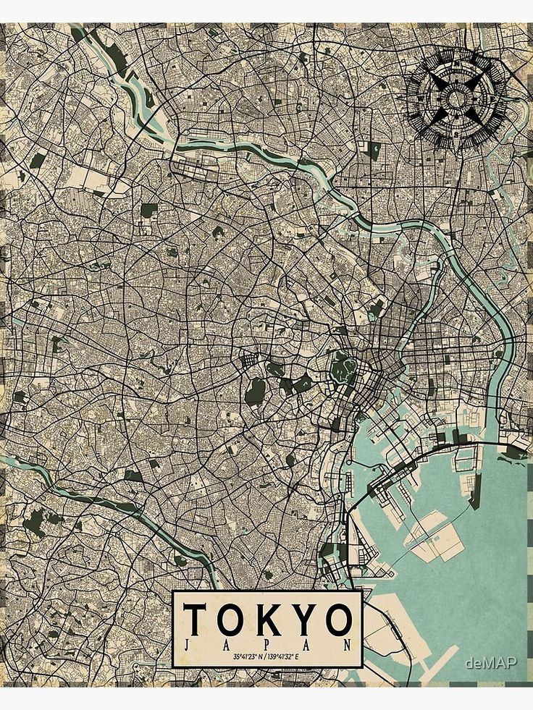
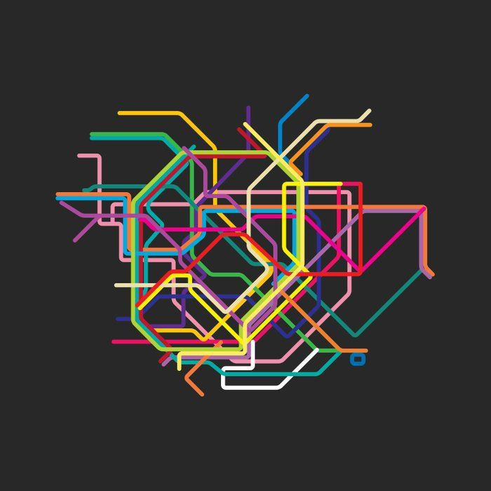
Important knowledge
1. SUICA and PASMO cards 2. Tokyo street map
3.Map of the
Tokyo
subway
system

Slide 13
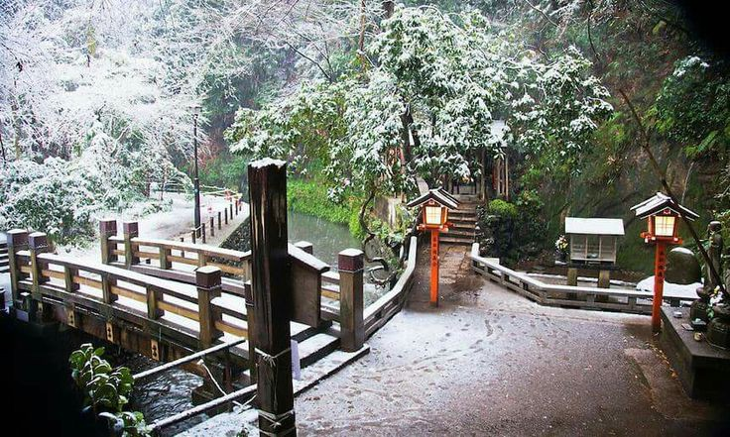
Climate and nature
Tokyo has a humid subtropical climate with hot summers and mild winters with cool spells. Due to its geographical position Tokyo sees typhoons every year, though they are not very strong.
Todoroki
Valley

Slide 14
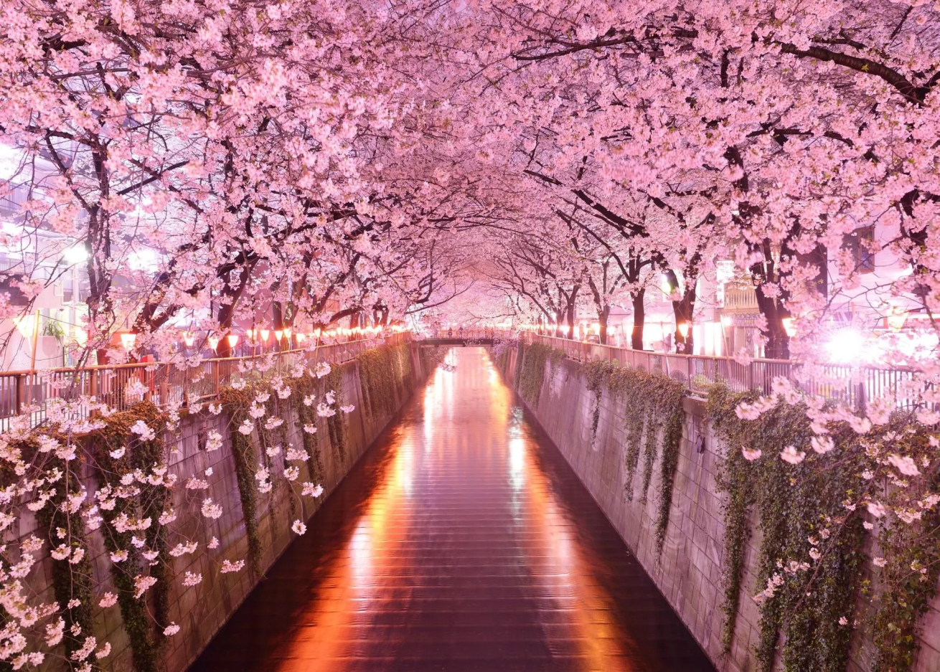
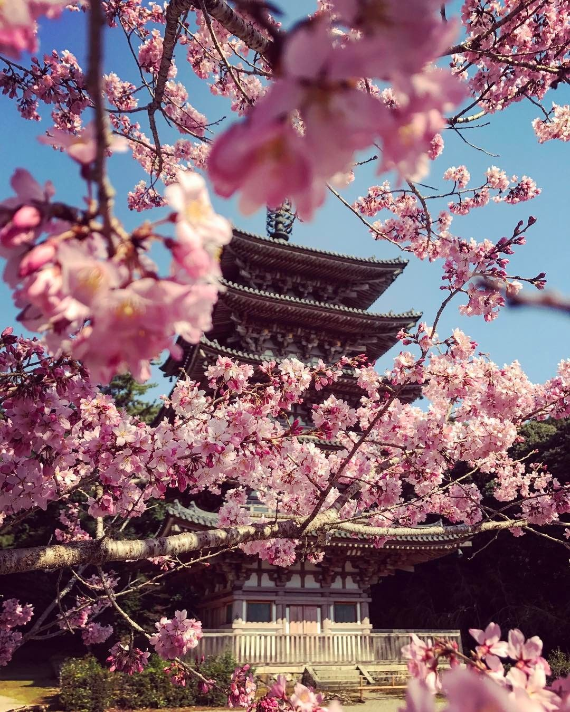
Cherry blossoms
The cherry blossom is the national symbol of Japan.

Slide 15
Thank you for your attention!

