Slide 1
Healthy fast food
Выполнила:
Тренина Елизавета 10А

Slide 2
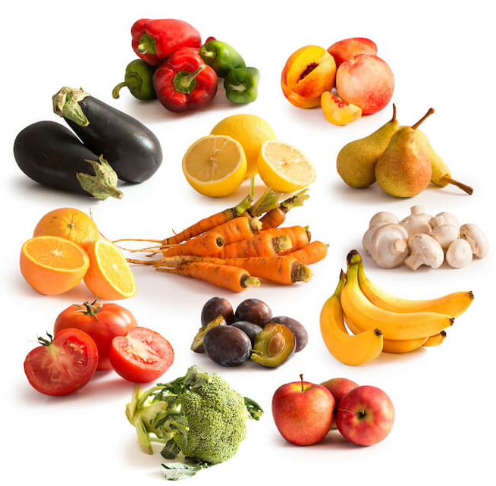
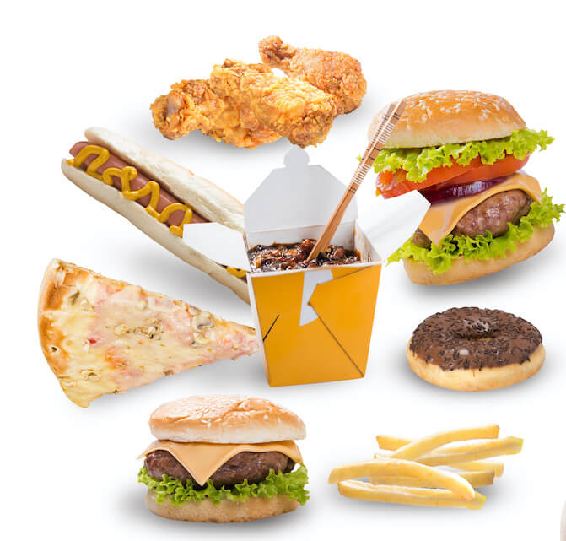
Healthy food and unhealthy food

Slide 3
Advantages and disadvantages of any diet
Advantages:
You stay healthy;
Your appearance improves
Disadvantages:
Sometimes it is hard to restrain yourself from eating unhealthy food;
Gaining more weight after following a diet

Slide 4
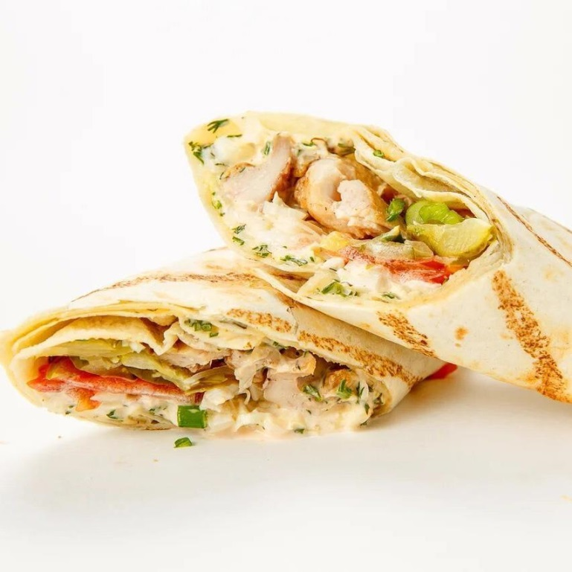
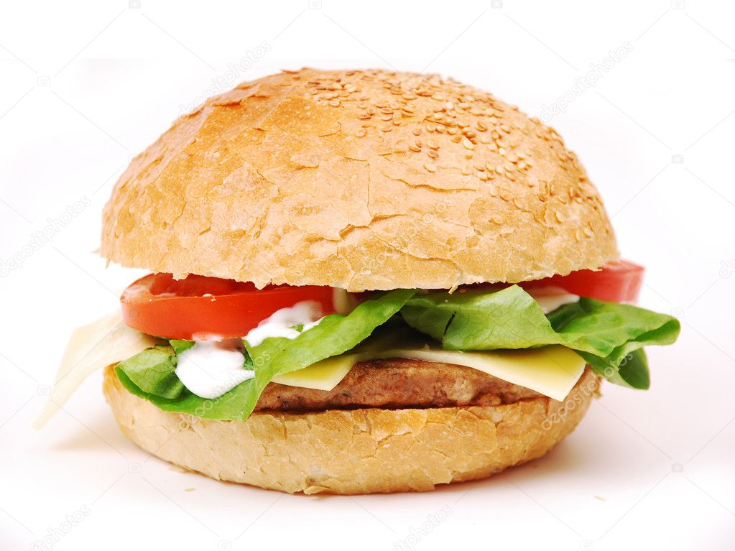
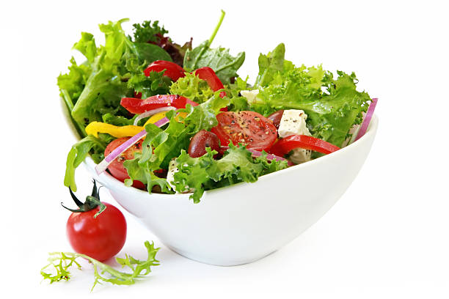
Eating out or home-made food
Home-made hamburgers, sandwiches
Salads
Home-made
spring rolls

Slide 5
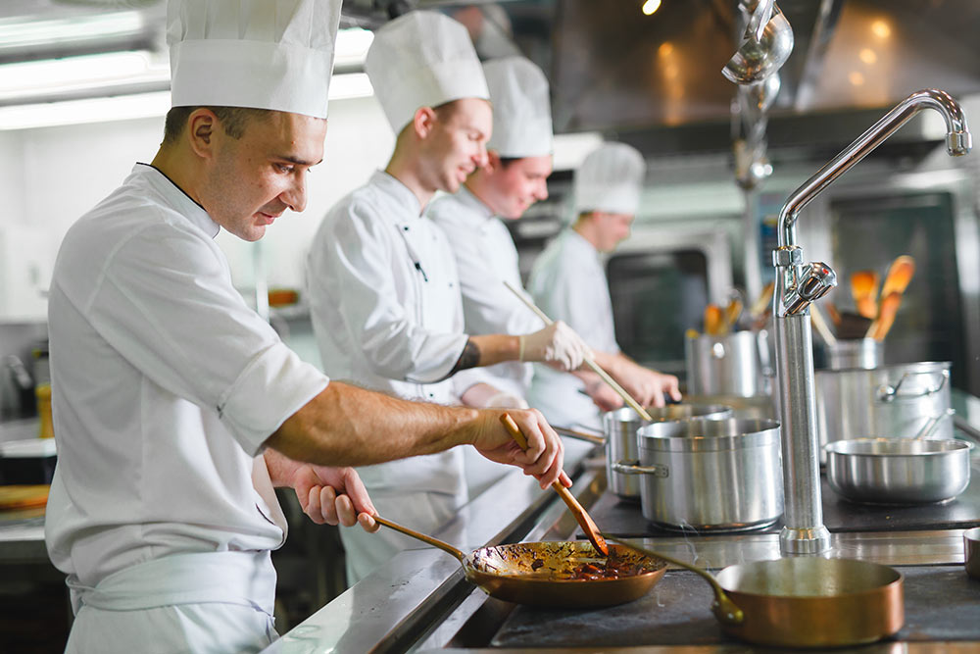
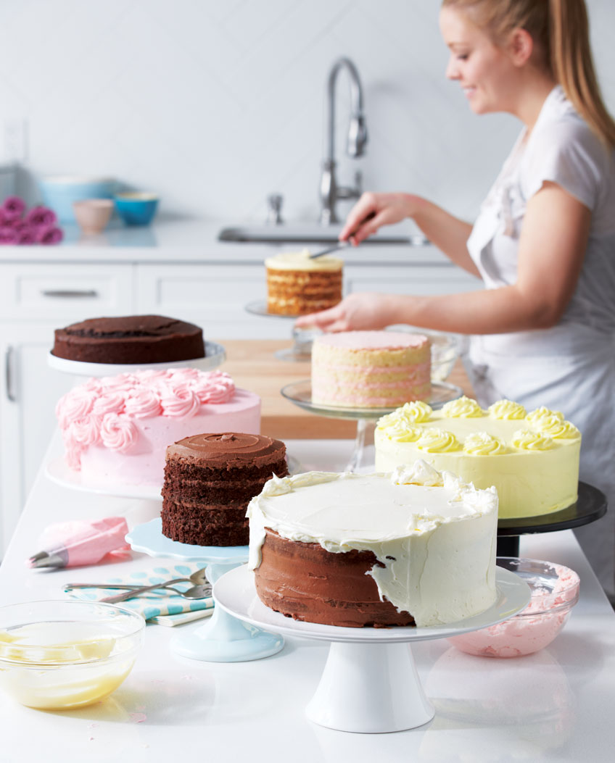
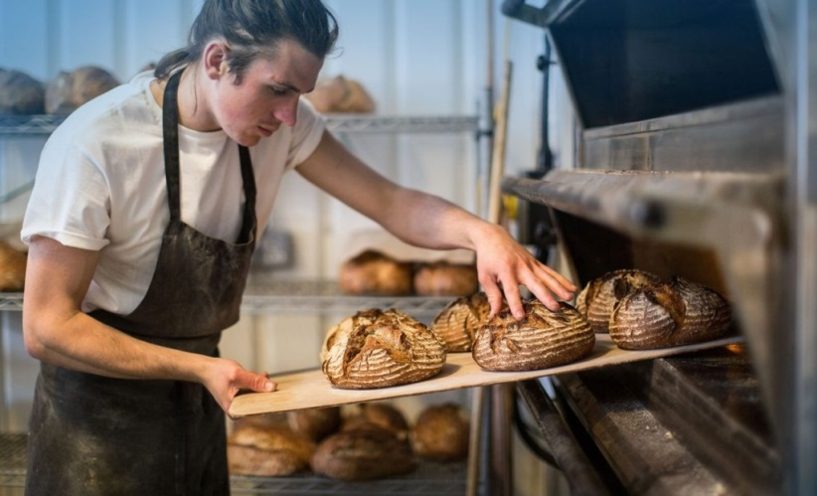
Are jobs connected with food popular nowadays?
Cook
Pastry cook
Baker

