Slide 1
Cultural awareness of the British Season
Муниципальное бюджетное образовательное учреждение
Средняя общеобразовательная школа №41
Канавинского района г. Н. Новгорода
Выполнила:
Исмайлова Камила, ученица 10 «А» класса
Научный руководитель:
Алексеева И. В., учитель английского языка
Нижний Новгород
2014 год

Slide 2
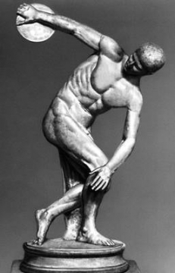
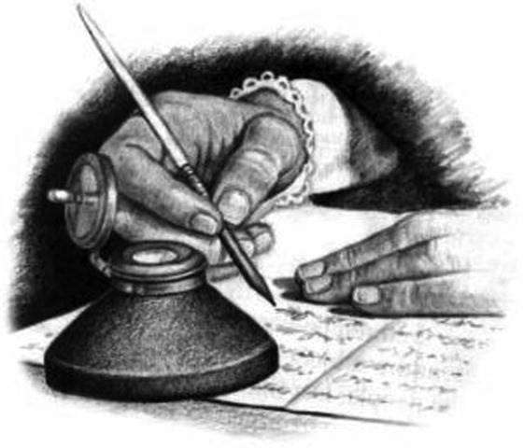
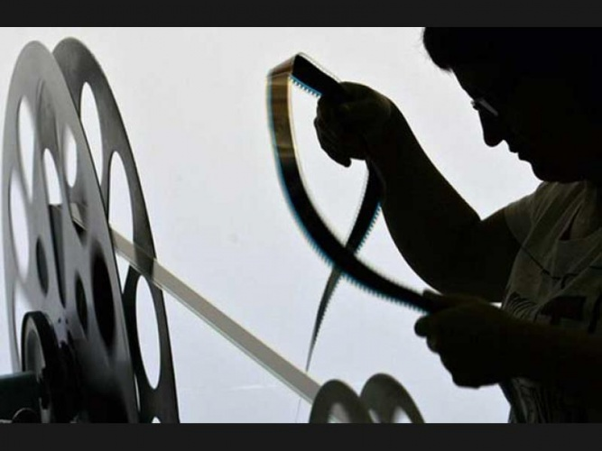
CULTURE
The dictionary defines culture as:
the beliefs, values, behaviour and material objects that constitute a people’s way of life;
any knowledge passed from one generation to the next.

Slide 3
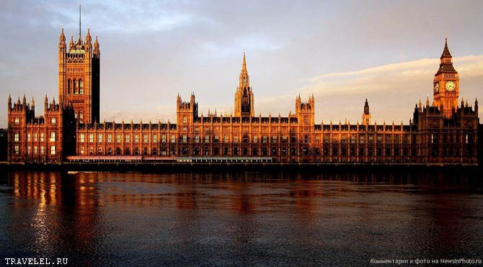
IMPORTANT:
If you educate yourself on the cultural and historical aspects of a country, you will better understand its social customs and traditions.

Slide 4
THE SEASON
a season is a subdivision of the year, marked by changes in weather, ecology and hours of daylight
the season may also refer to: film and television, music and entertainment, video games, etc.
SEASON
Season as a series of events, which are enjoyed by members of British aristocracy.

Slide 5
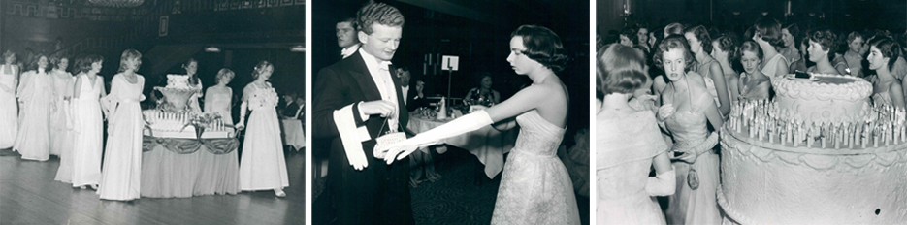
HISTORY
The London Season has a very rich history, formed over two hundred years ago when, for several months of the year, fabulous balls and parties took place, by 1780 the custom of returning to London at the end of the hunting season for this purpose was well established. King George III held a May ball, which was launched to raise money for a new maternity hospital, named after his wife Queen Charlotte. This became an annual event and Queen Charlotte’s Ball became the most important ball of the social calendar, and is still held in high regard today.

Slide 6
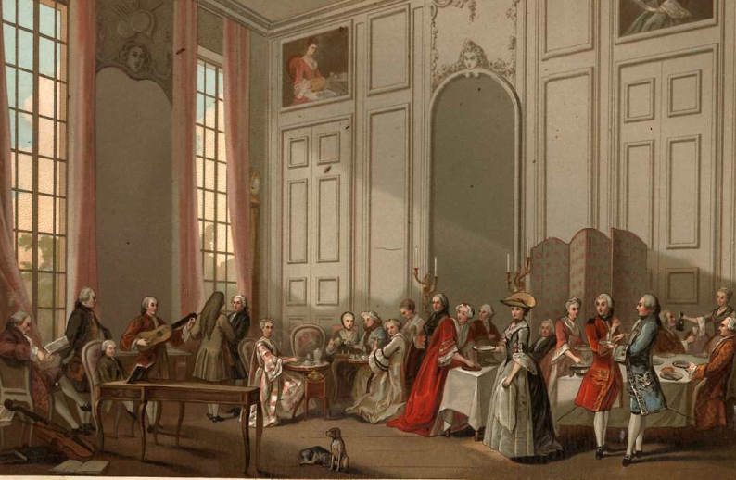
IMPORTANT:
Social skills, deportment and elegance are still important and actual in British society. Basic politeness rules are never wasted. The British season has a great cultural and educational value, it helps young people to become the members of society, learning to participate in the culture.

Slide 7
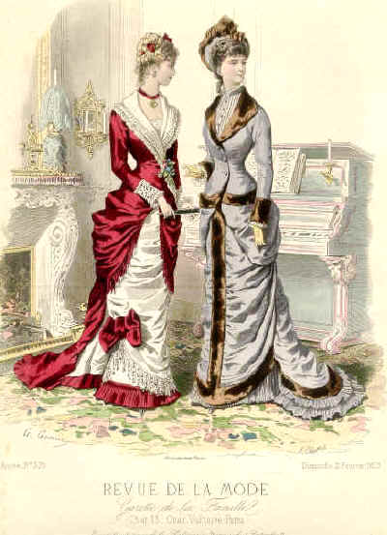
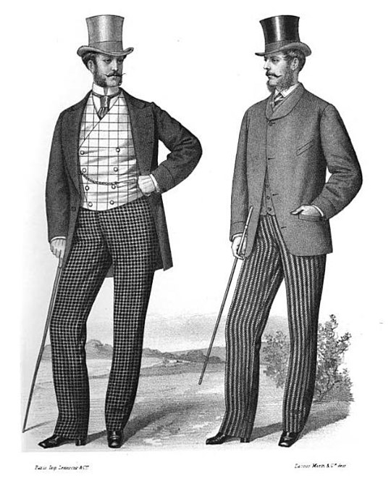
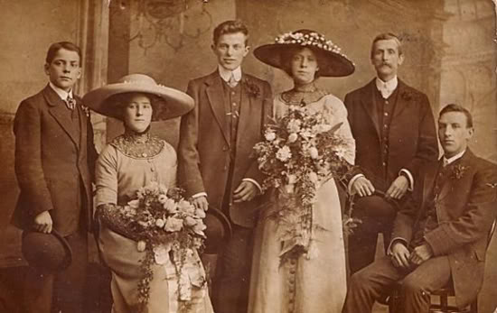
APPROCIATE DRESS CODE
Edwardian times
Victorian times

Slide 8
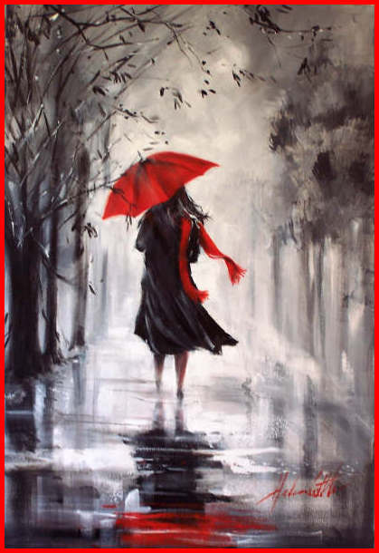
«If people turn to look at you on the street, you are not well dressed”.
(Beau Brummel)

Slide 9
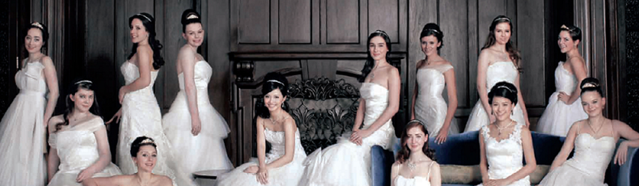
«A woman must have a thorough knowledge of music, singing, drawing, dancing, and the modern languages to deserve the world; and besides all this, she must possess a certain something in her air and manner of walking, the tone of her voice, her address and expressions, or the world will be but half deserved».
(Jane Austen)

Slide 10
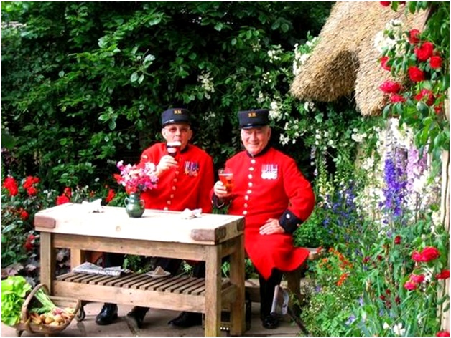
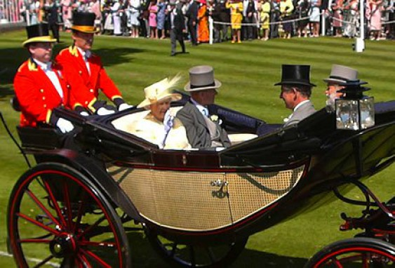
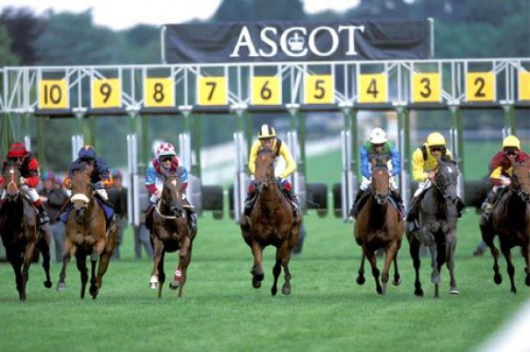
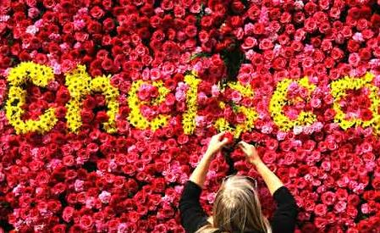
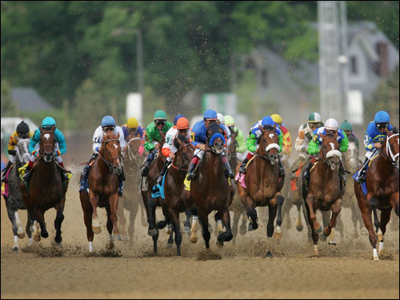
RETAINS OLD TRADITIONS.
SUPPORTS THE IDEA OF CHARITY

Slide 11
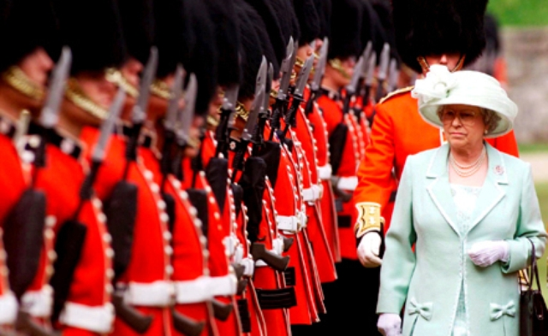
CINQUAIN
Season
Cultural, social
Participate, wear, behave
Help to become a member of society
Socialization

Slide 12
Thank you for your attention!

