Slide 1
Body language.
4 types of emotions.
Lukoyanova anastasia, 11а

Slide 2
Introduction
Body language - symbolic elements of postures and movements of various parts of the body, which help us understand other people's emotions, thoughts and feelings.

Slide 3
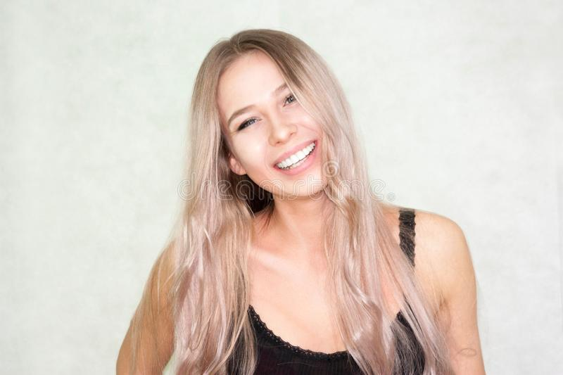
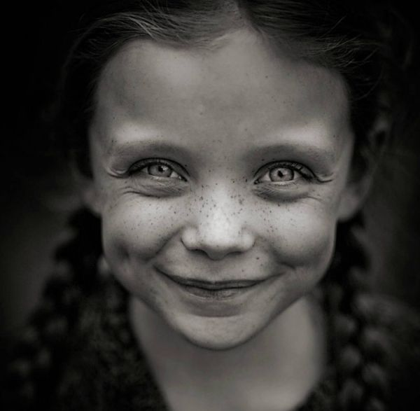
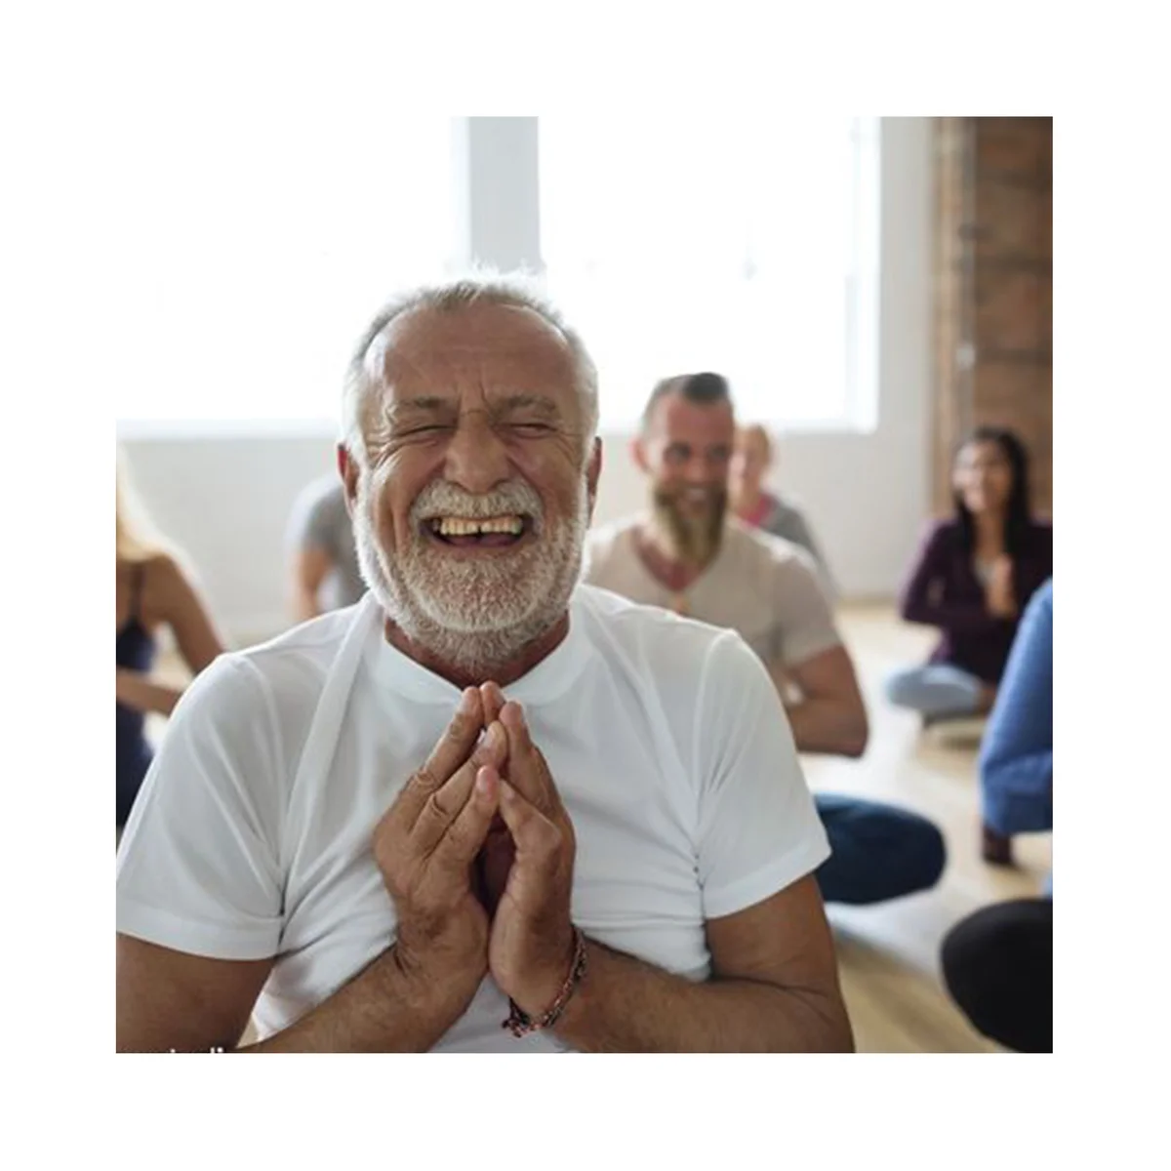
Joy
wrinkles on the corners of the eyes
raised lower eyelids
raised cheeks
the corners of the lips are pulled back and up (person is smiling)

Slide 4
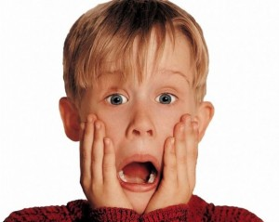
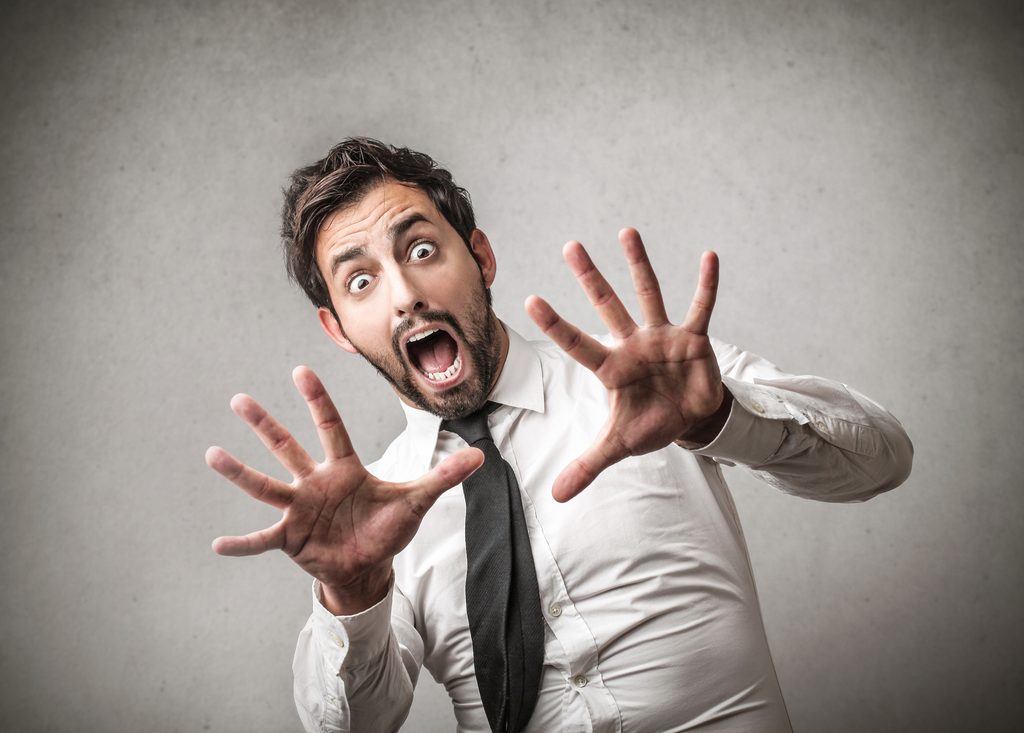
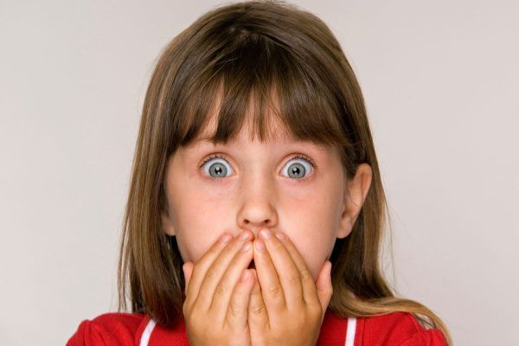
Fear
raised eyebrows
wide open eyes
down corners of the lips
open mouth

Slide 5
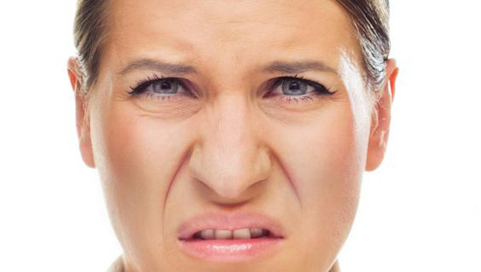

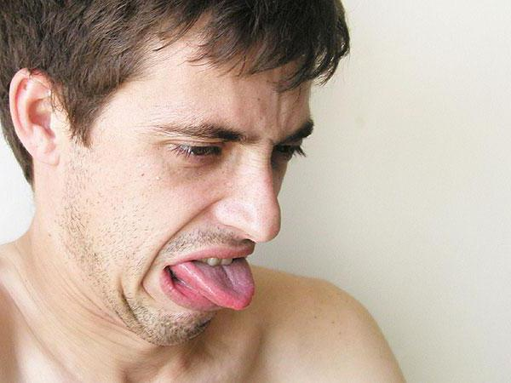
Aversion
down eyebrows
wrinkled nose
down corners of the lips
open mouth

Slide 6
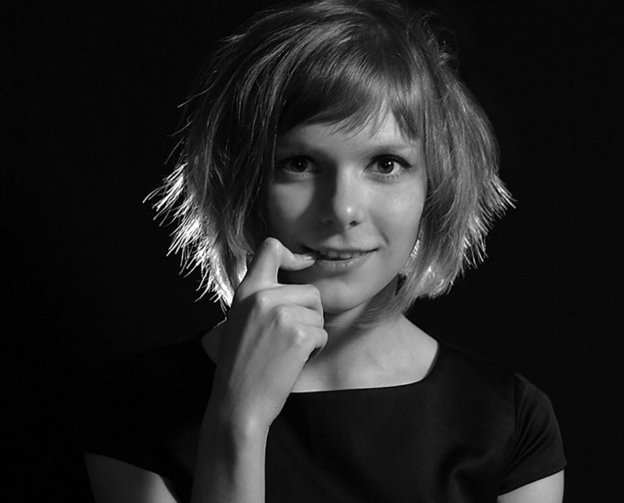
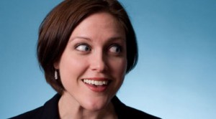
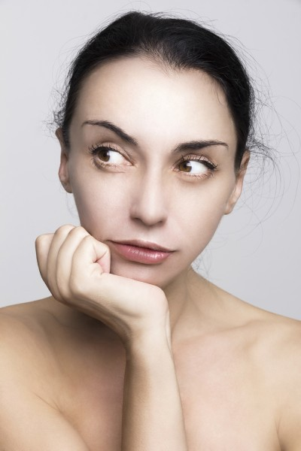
Interest
raised eyebrows
the gaze is directed to the object
raised corners of the lips
closed/open mouth

Slide 7
Conclusion
Body language is a very interesting and useful form of non-verbal communication.

Slide 8
Thank you for your attention!

